Slide 1

Inventions

Slide 2

Compass

Slide 3
Despite the advanced technologies available today, the compass still functions as a navigation system for many explorers. It was first used in the 14th century. Keep in mind that explorers then could never have reached their destinations without this amazing invention that made our history completely different.
Despite the advanced=παρά τις προηγούμενες
Keep in mind that =βάλετε υπόψη
Century=αιώνα

Slide 4


Slide 5
Printer

Slide 6
The ideas for a system with "printing house" specifications were already widespread from the 11th century. However, the German inventor Johann Gutenberg made this idea a reality. He was the one who invented the mobile printing system in 1430, creating "upheaval" around the world. The mobile printing press has a huge impact on the world, as it has even made books very accessible to middle-class families. Today, of course, there are innumerable advanced and state-of-the-art printing systems used all over the world.
Widespread=διαδεδομένες
Innumerable=αμέτρητος
Turmoil=αναταραχή
Accessible=προσιτός

Slide 7
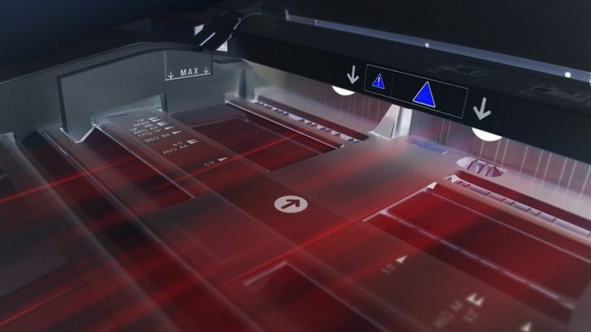

Slide 8
Television
Television (TV), sometimes shortened to tele or telly, is a telecommunication medium used for transmitting moving images in monochrome (black and white), or in color, and in two or three dimensions and sound. The term can refer to a television set, a television show, or the medium of television transmission. Television is a mass medium for advertising, entertainment, news, and sports
Television became available in crude experimental forms in the late 1920s, but it would still be several years before the new technology would be marketed to consumers.

Slide 9
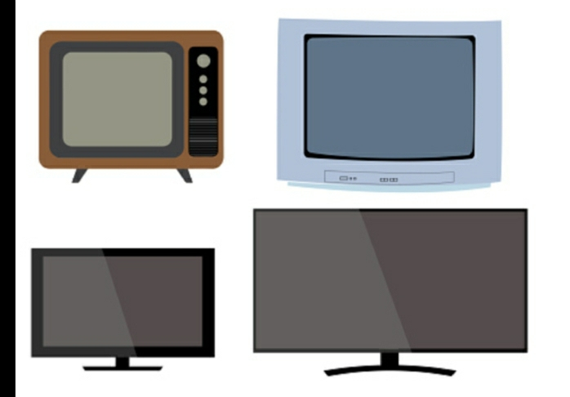

Slide 10
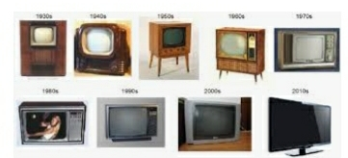

Slide 11
Microwave
Microwaves are a form of electromagnetic radiation with wavelengths ranging from about one meter to one millimeter; with frequencies between 300 MHz
Microwaves travel by line-of-sight; unlike lower frequency radio waves they do not diffract around hills, follow the earth's surface as ground waves, or reflect from the ionosphere, so terrestrial microwave communication links are limited by the visual horizon to about 40 miles (64 km). At the high end of the band they are absorbed by gases in the atmosphere, limiting practical communication distances to around a kilometer.

Slide 12
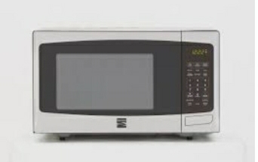

Slide 13
The computer history

Slide 14
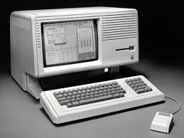

Slide 15
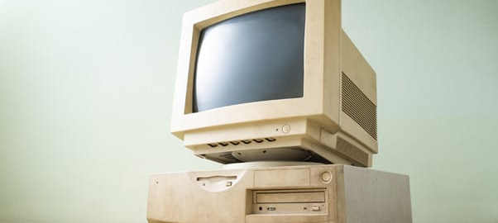

Slide 16
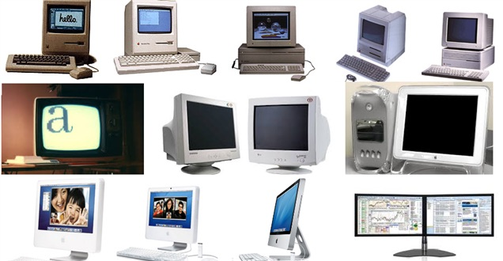

Slide 17
The computer was born not for email but out of a need to solve a serious number-crunching crisis. By 1880, the U.S. population had grown so large that it took more than seven years to tabulate the U.S. Census results. The government sought a faster way to get the job done, giving rise to punch-card based computers that took up entire rooms.
*solve a serious number-crunching crisis = λύσει μια σοβαρή κρίση για τον αριθμό
*to tabulate the U.S. Census results = για να καταγραφούν τα αποτελέσματα της αντιγραφής των Η.Π.Α
* government sought = ζητήθηκε από την κυβέρνηση

Slide 18
THANKS FOR WATCHING
GROUP C

