Slide 1
PARIS, FRANCE
Our Favorite City

Slide 2
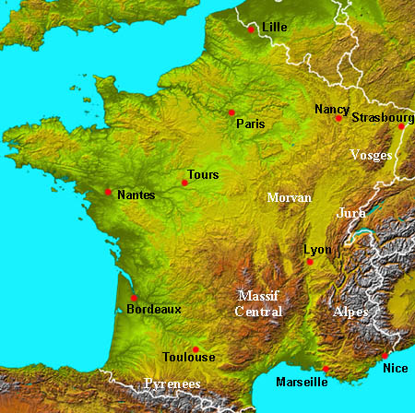
GEOGRAPHICAL
FEATURES
France’s location has helped the country to develop. France is near the Mediterranean sea, so it has Mediterranean climate.
France borders with many countries like Spain, Italy, Austria, Germany, Belgium, and Luxembourg.
It has ports in both in Mediterranean Sea and Atlantic Ocean.

Slide 3
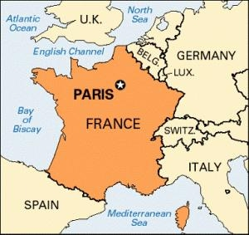
LOCATION
Paris is the capital city and the most populous city of France is a country which belongs to European Union. It is located in southwestern of Europe. Specifically, north from Spain, northwestern from Italy, southwestern from Germany and south from United Kingdom and Ireland.

Slide 4
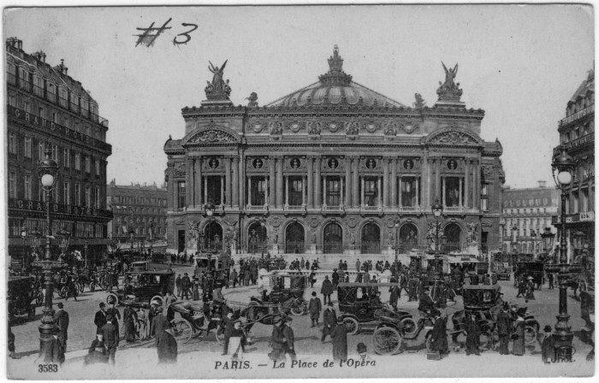
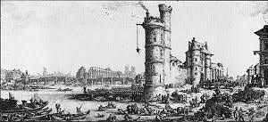
HISTORY
The oldest known site of human habitation in Paris, a settlement of hunter-gatherers dating to between 9000 and 7500 BC, was found in 2006 near the Seine on rue Henri-Farman in the 15th arrondissement. The Parisii, a sub-tribe of the Celtic Senones, inhabited the area near the river Seine from around 250 BC, building a trading settlement on the island, later the Ile de la Cite, the easiest place to across. They minted their own coins and traded by river with towns on the Rhine and the Danube, and also with Spain.

Slide 5
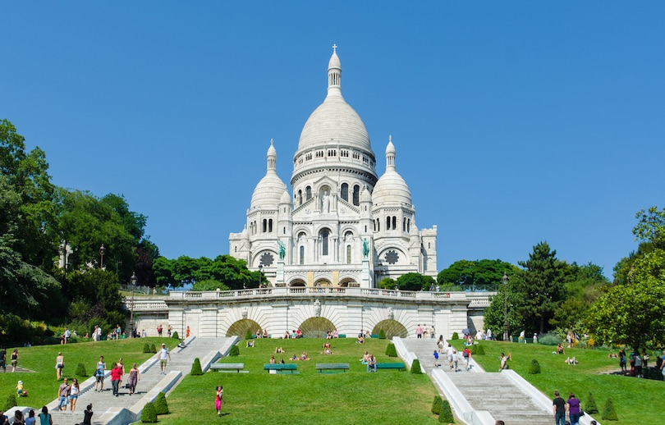
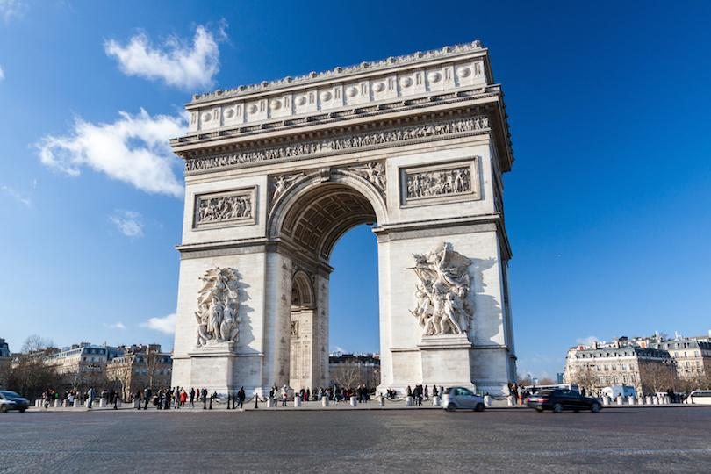
SIGHTS
Paris top sights are the Eifel Tower which is located on the Camp de Mars in Paris (it was named after the engineer Gustave Eiffel, whose company designed and built the tower) and the Arc de Triomphe which stands in the center of the Place Charles de Gaulle (originally name ‘Place de l’ Etoile’)at the western end of the Champs-Elysees and honors those who fought and died for France in the French. Revolutionary and the Napoleonic Wars with names of all friends victories and generosity inscribed on its inner and outer surfaces.

Slide 6
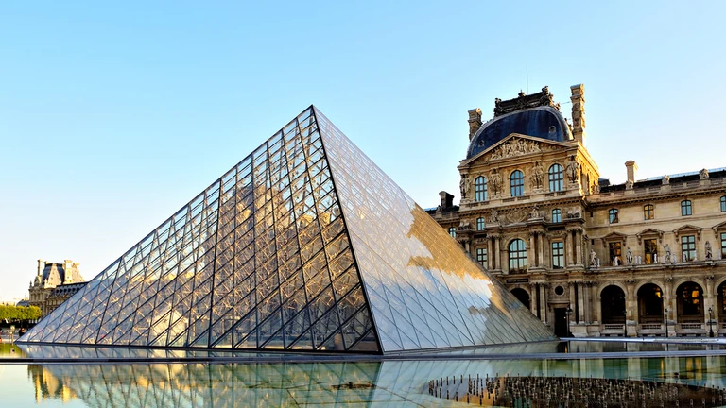
THE LOUVRE MUSEUM
The Louvre Museum is very popular due to the culture they have.
The Louvre Museum is the world’s the largest art museum and a historic monument in Paris, France.
A central landmark of the city, it is located on the Right Bank of the Seine in the city’s 1st arrondissement.
Approximately 38,000 objects from prehistory to the 21st century are exhibited over an area of 72,735 square meters (782,910 square feet).
In 2018 the Louvre was the world’s most visited art museum, receiving 10,2 million visitors.

Slide 7
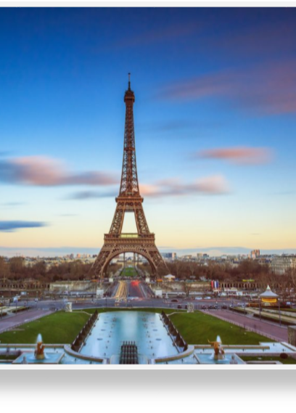
THE EIFEL TOWER
The Eifel Tower is very opened to the
people and often visit it. It is one
of the most famous sites of the world.

Slide 8
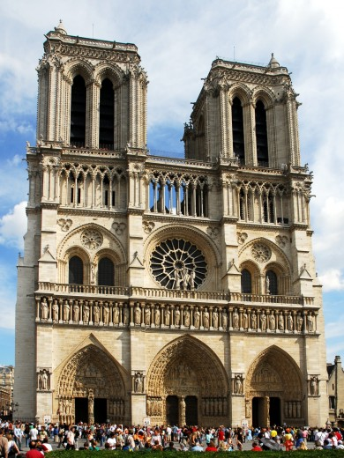
NOTRE-DAME
Notre-Dame de Paris French: meaning "Our Lady of Paris"), referred to simply as Notre-Dame, is a medieval Catholic cathedral on the Île de la Cité in the 4th arrondissement of Paris. The cathedral was consecrated to the Virgin Mary and considered to be one of the finest examples of French Gothic architecture. Its pioneering use of the rib vault and flying buttress, its enormous and colorful rose windows, as well as the naturalism and abundance of its sculptural decoration set it apart from the earlier Romanesque style.[7] Major components that make Notre Dame stand out include one of the world's largest organs and its immense church bells.[8]

Slide 9
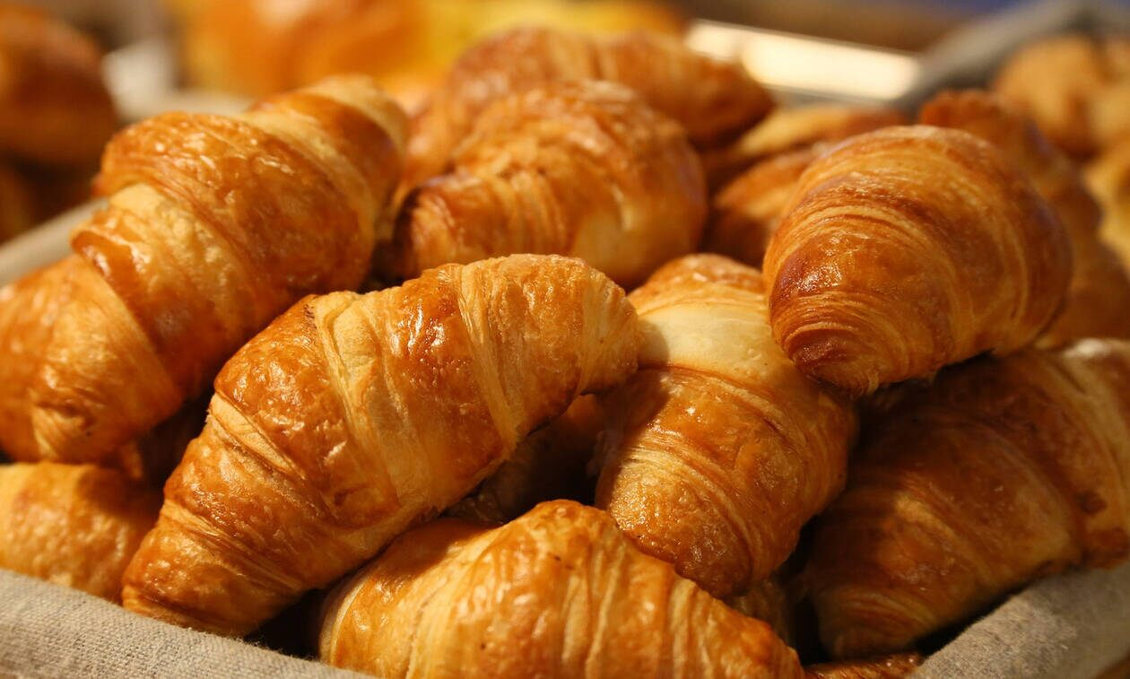
THE CROISSANTS
Croissants are one of the best seller products in France and many people eat it for a yummy breakfast. It is original for this country.

Slide 10
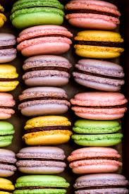
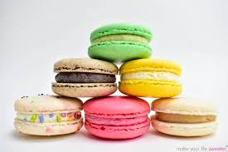
MACARONS
A macaron French: or French macaroon is a sweet meringue-based confection made with egg white, icing sugar, granulated sugar, almond meal, and food coloring. There is some variation in whether the term macaron or macaroon is used, and the related coconut macaroon is often confused with the macaron. In English, some bakers have adopted the French spelling of macaron for the meringue-based item to distinguish the two. Stanford professor of linguistics Daniel Jurafsky describes how the two confections have a shared history with macaroni (Italian mancheron). notes that French words ending with "-on" that were borrowed into English in the 16th and 17th centuries are usually spelled with. In the UK, many bakeries continue to use the term "macaroon".

Slide 11
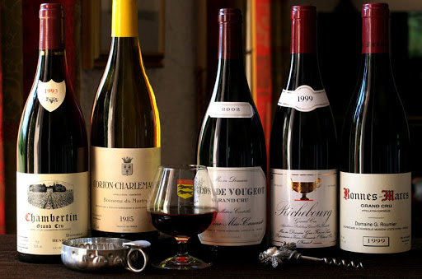
French Wines
French wine is produced all throughout France, in quantities between 50 and 60 million hectoliters per year, or 7–8 billion bottles. France is one of the largest wine producers in the world, along with Italian, Spanish, and American wine-producing regions. French wine traces its history to the 6th century BC, with many of France's regions dating their wine-making history to Roman times. The wines produced range from expensive wines sold internationally to modest wines usually only seen within France such as the Mar gnat wines were during the post war period.
Two concepts central to the better French wines are the notion of terroir, which links the style of the wines to the locations where the grapes are grown and the wine is made and the Appellation d'origine contrôlée system, replaced by the Appellation d'origine Protégée system in 2012. Appellation rules closely define which grape varieties and winemaking practices are approved for classification in each of France's several hundred geographically defined appellations, which can cover regions, villages or vineyards.
France is the source of many grape varieties (such as Cabernet Sauvignon, Chardonnay, Pinot noir, Sauvignon blanc, Syrah) that are now planted throughout the world, as well as wine-making practices and styles of wine that have been adopted in other producing countries. Although some producers have benefited in recent years from rising prices and increased demand for some of the prestige wines from Burgundy and Bordeaux, the French wine industry has seen a decline in domestic consumption and internationally, it has had to compete with many new world wines.

Slide 12
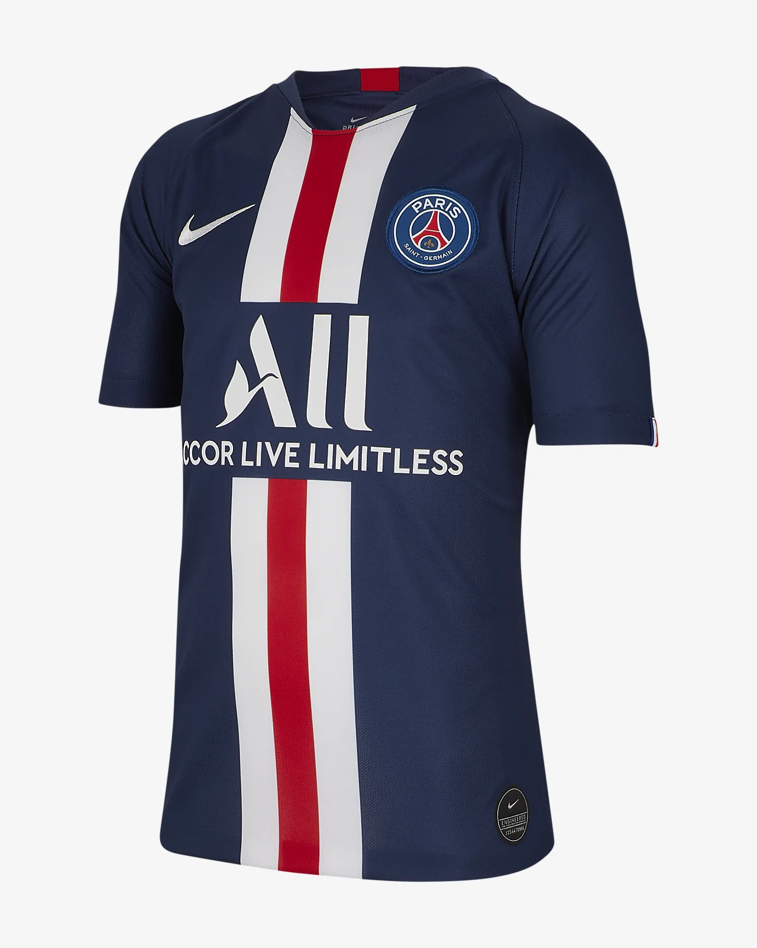
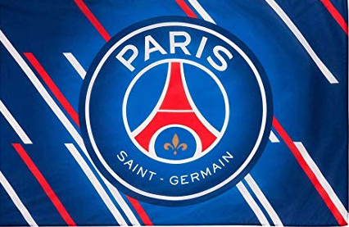
PARIS SAINT GERMAIN
Paris Saint Germain commonly referred to as P.S.G., is a French professional F.C. based in Paris. Founded in 1970, the club has traditionally worn red and blue kits. P.S.G. has played their home matches in the 47,929-capacity Parc des Princes in the 16th arrondissement of Paris since 1974. The club plays in the highest tier of French football, Ligue 1.

Slide 13
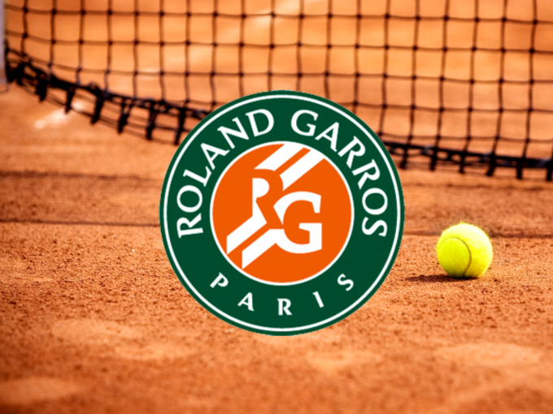
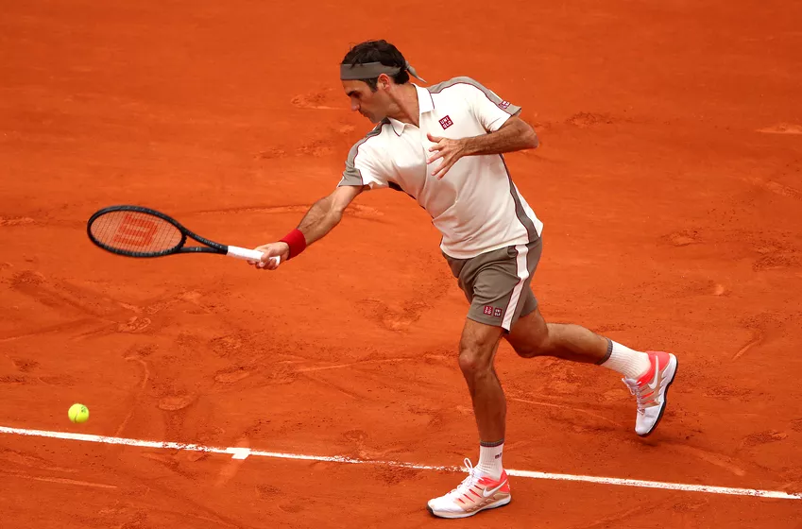
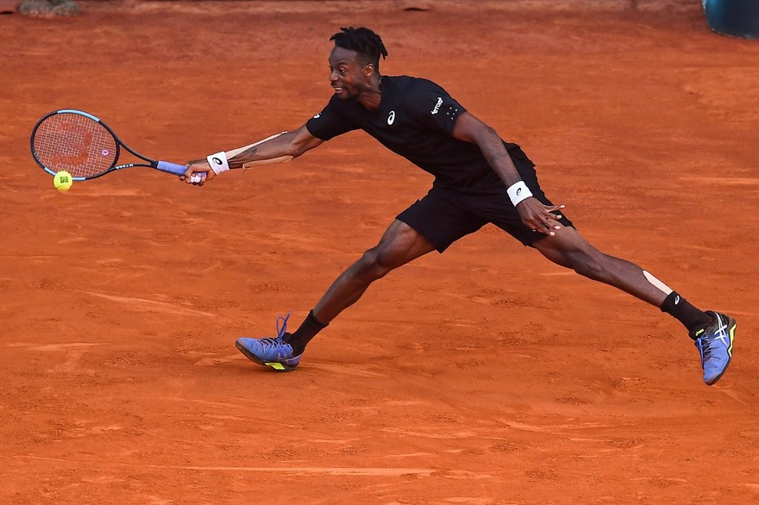
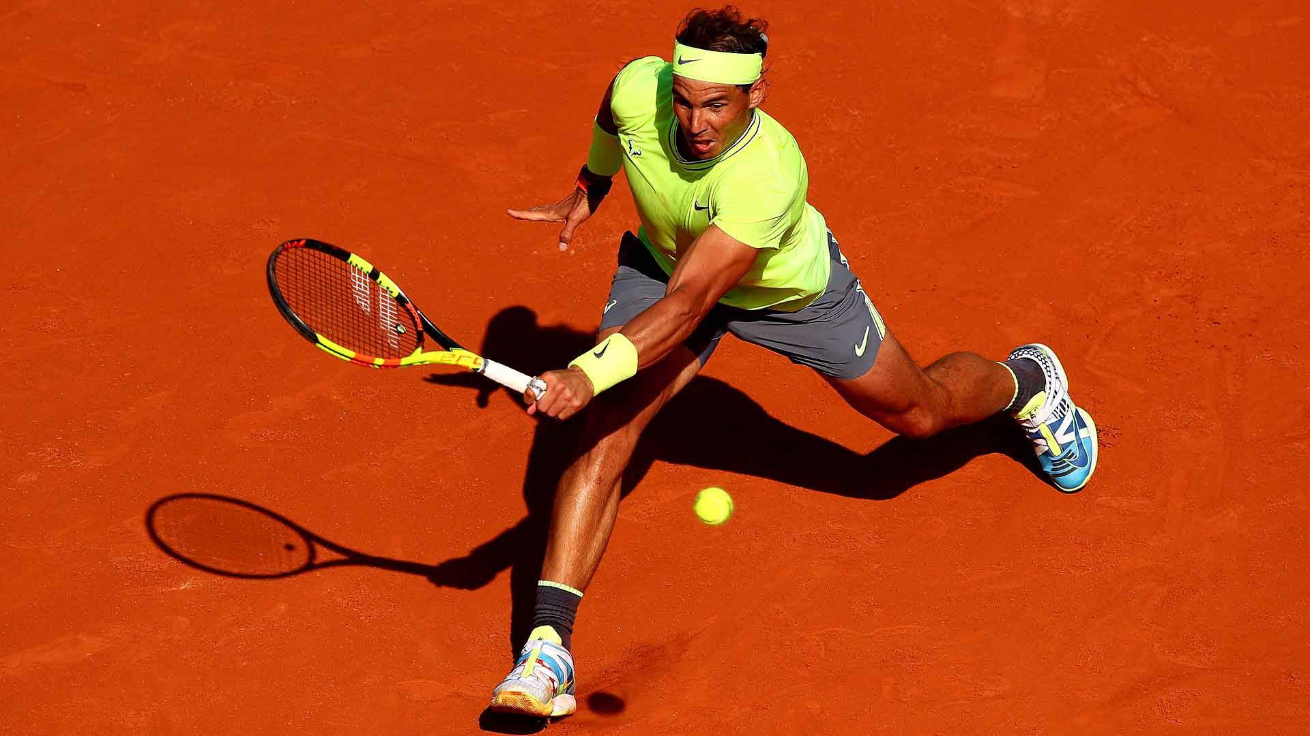
ROLAND GARROS
The French Open, officially Roland Garros, a major tennis tournament held over two weeks at the Stade Roland Garros in Paris, in France, beginning in late May. The venue is named after the French aviator Roland Garros. It is the premier clay court tennis championship event in the world and the second of four annual Grand Slam tournaments, the other three being the Australian Open, Wimbledon and the US Open. The French Open is currently the only Grand Slam event held on clay, and it is the zenith of the spring clay court season. Because of seven rounds needed for a championship, the slow-playing surface and the best-of-five-set men’s singles matches (without a tiebreak in the final set)the event is widely considered to be the most physically demanding tennis tournament in the world.

Slide 14
ΕΥΧΑΡΙΣΤΟΥΜΕ ΠΟΛΥ
ΟΙ ΜΑΘΗΤΕΣ ΤΟΥ ΣΤ’1
THANK YOU FOR WATCHING
THE STUDENTS OF ST’1
GROUP B
See you on next power point presentation

