Slide 1
The most famous countries in the world

Slide 2
U.S.A
The United States of America(USA), commonly known as the United States (US or U.S.) or America, is a country mostly locates in central North America, between Canada and Mexico. It consists of 50 states, a federal district, five major self-governing ,territories and various possessions. At 3.8 million square miles (9.8 million square kilometres), it is the worlds third-or fourth-largest country by total area. With a population of over 328 million, it is the third most populous country in the world. The country’s capital is Washington, D.C., and its most populous city is New York City.

Slide 3
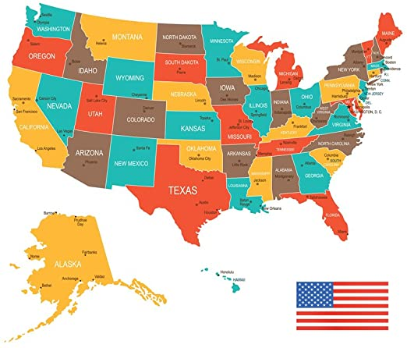
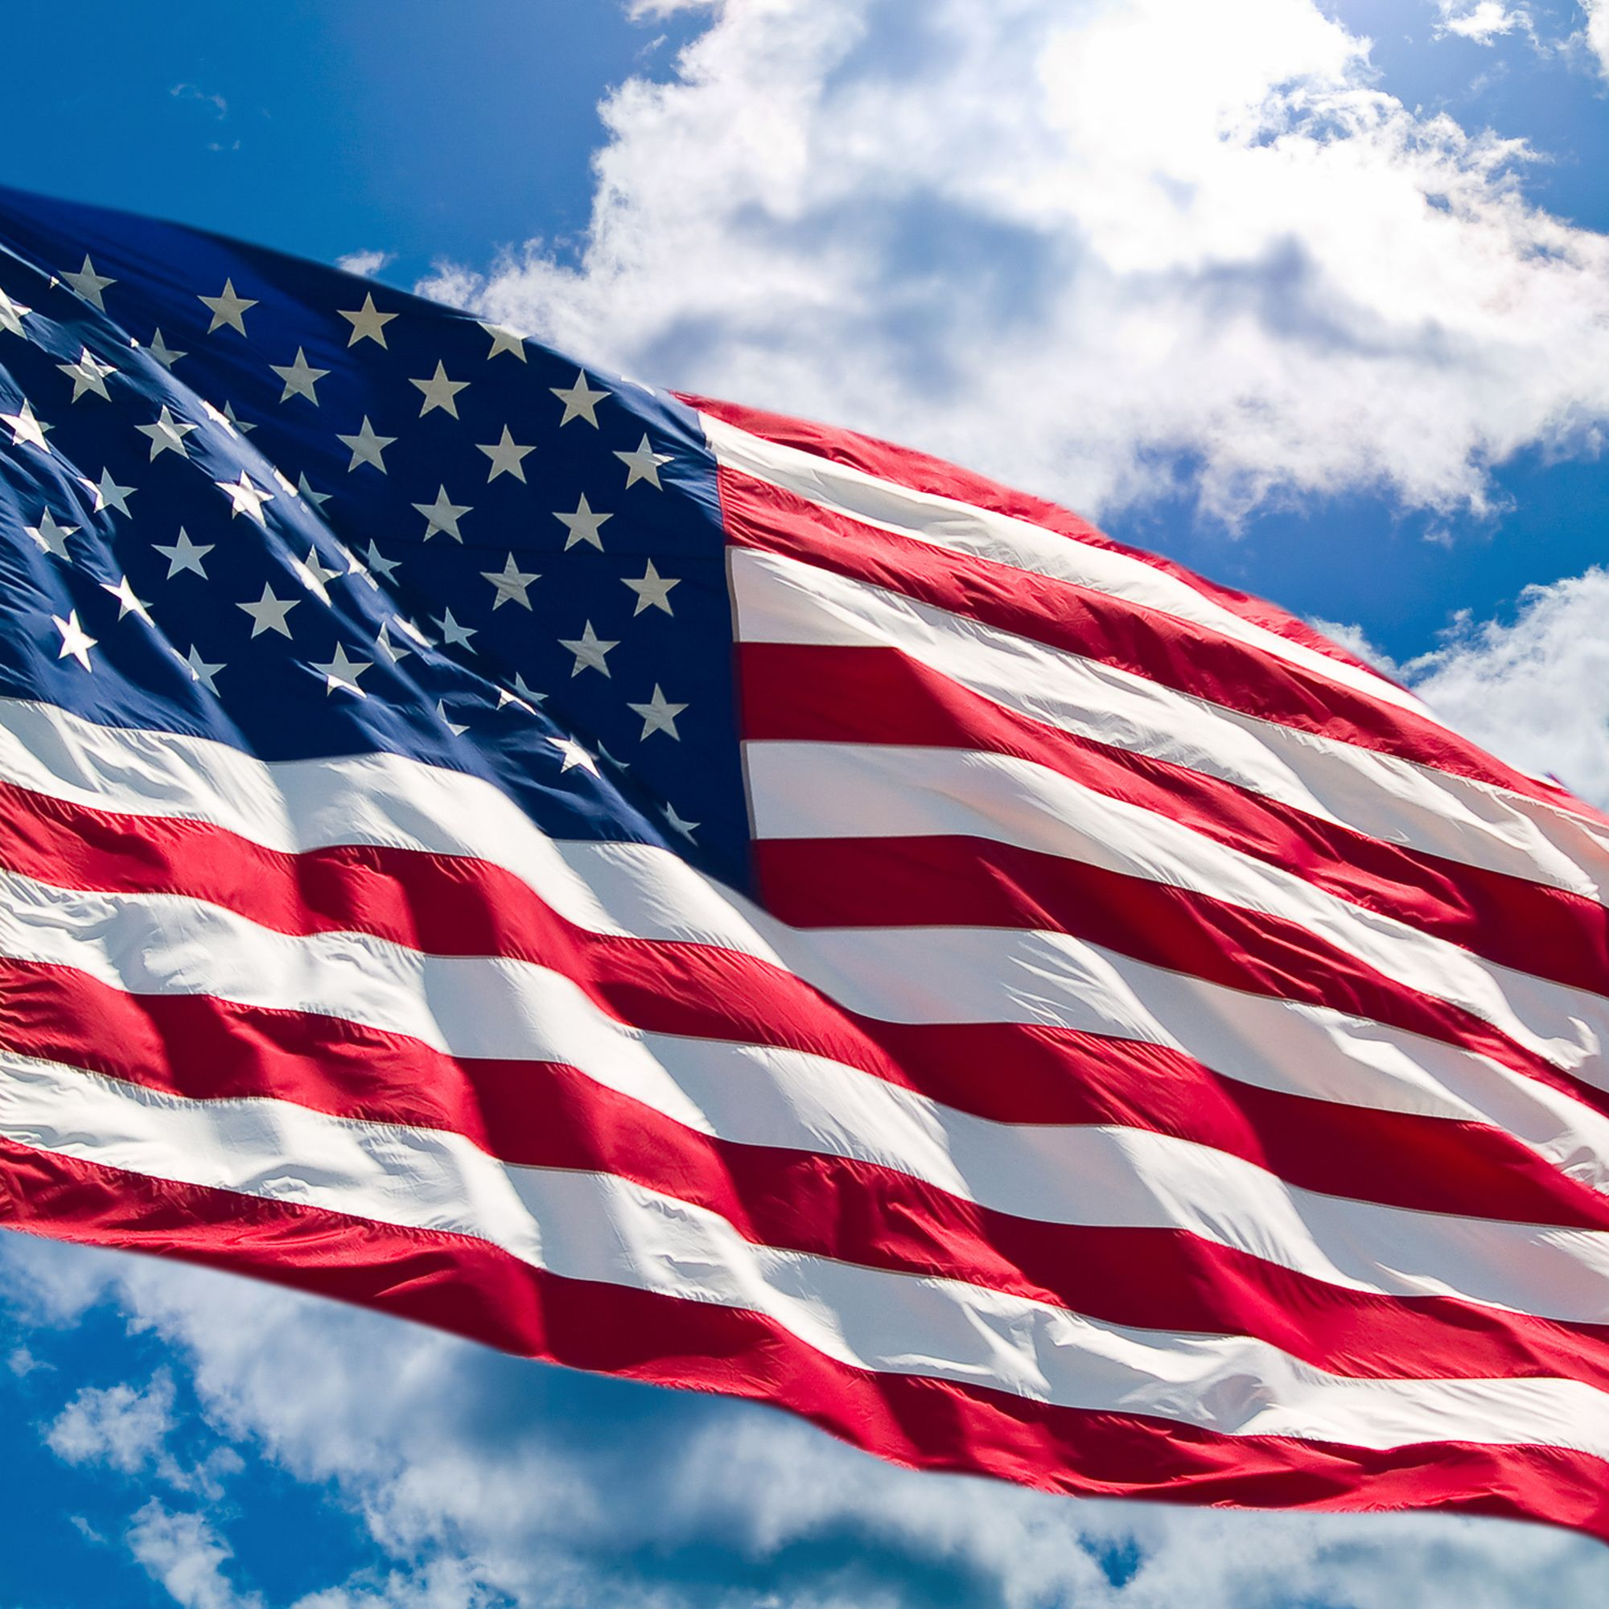
U.S.A

Slide 4
U.K
The United States of Great Britain and Northern Ireland commonly known as the United Kingdom (UK or U.K.) or Britain is a sovereign country located off the northwestern coast of the European mainland. The United Kingdom includes the island of Great Britain, the northeastern part of the island of Ireland, and many smaller islands. Northern Ireland shares a land border with the Republic of Ireland. Otherwise, the United Kingdom is surrounded by the Atlantic Ocean, with the North Sea to the east, the English Channel to the south and the Celtic Sea to the southwest, giving it the 12th-longest coastline in the world.

Slide 5
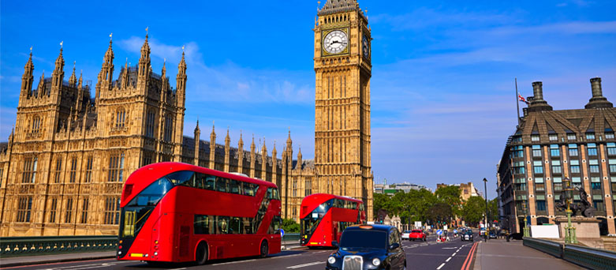
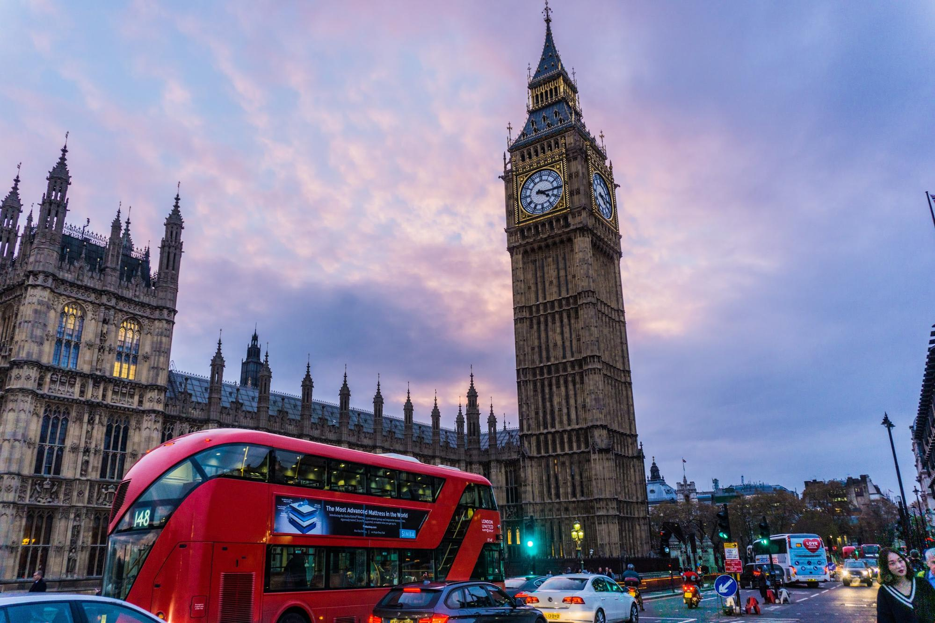
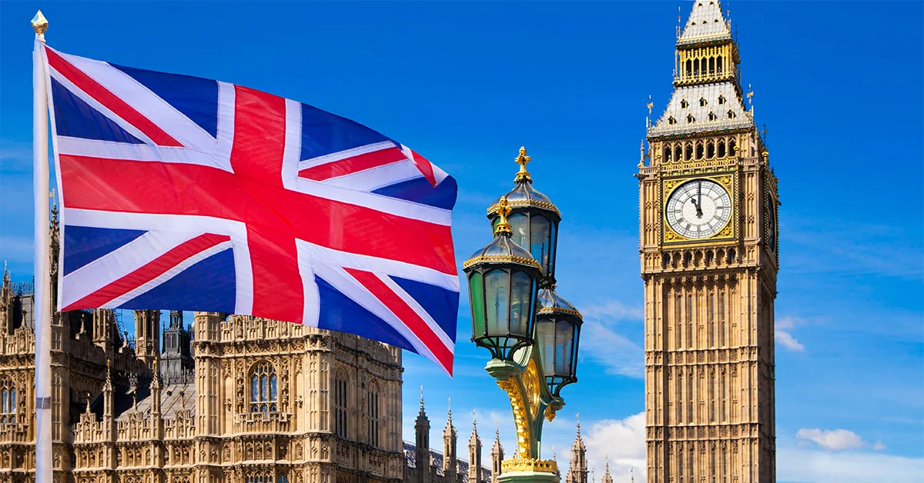
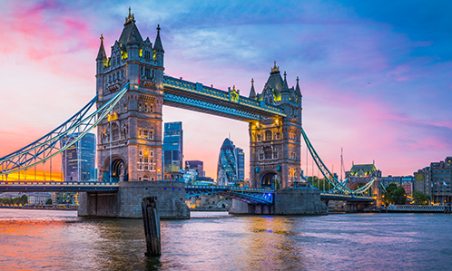

Slide 6
Italy
Italy, officially the Italian Republic is a country consisting of a peninsula delimited by Alps and surrounded by several islands. Italy is located in south-central Europe, and is considered part of western Europe. A unitary parliamentary republic with Rome as its capital, the country covers a total area of 301,340km and shares land borders with France, Switzerland, Austria, Slovenia, and the enclaved microstates of Vatican City and San Marino. Italy has a territorial enclave in Switzerland and a maritime exclave in Tunisian waters. With around 60 million inhabitants, Italy is the third-most populous member state of European Union.

Slide 7
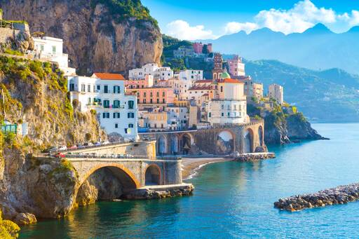
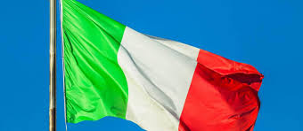
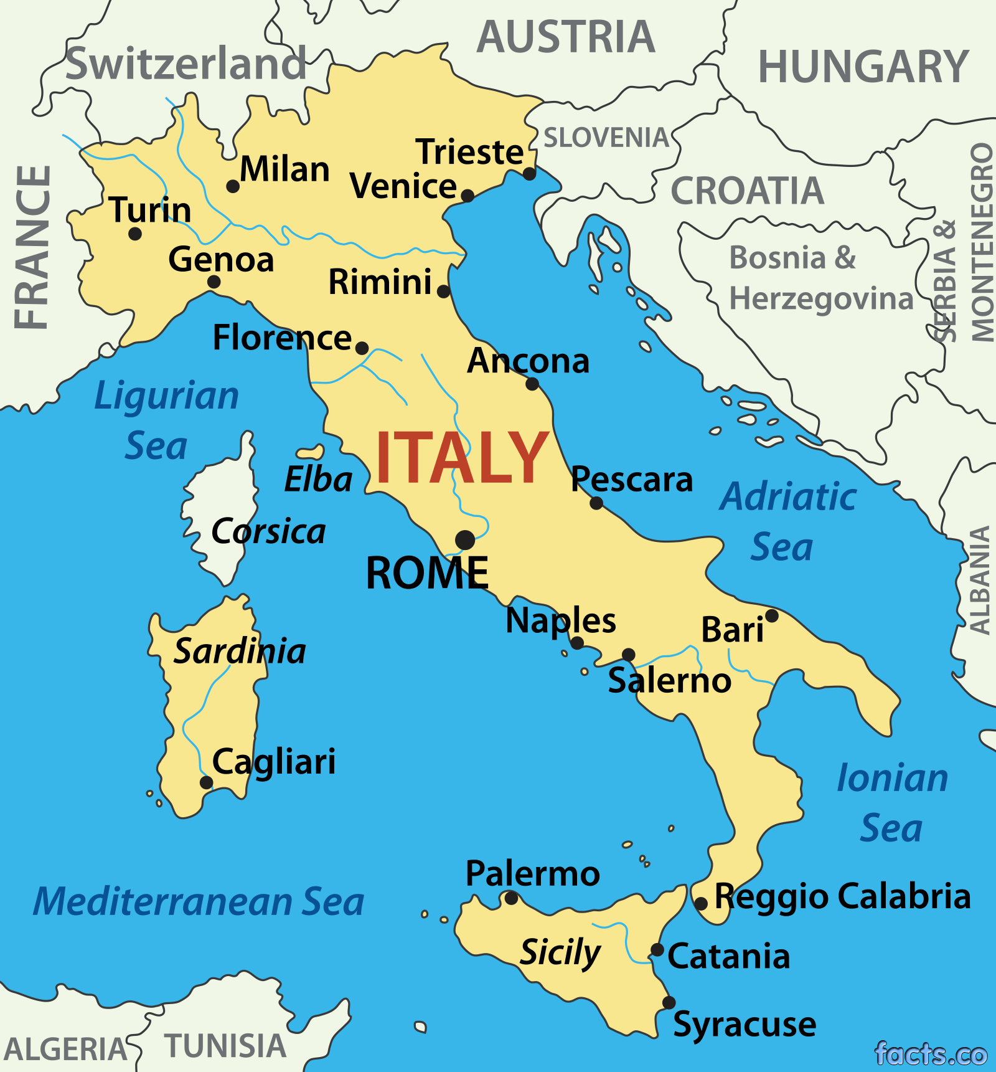
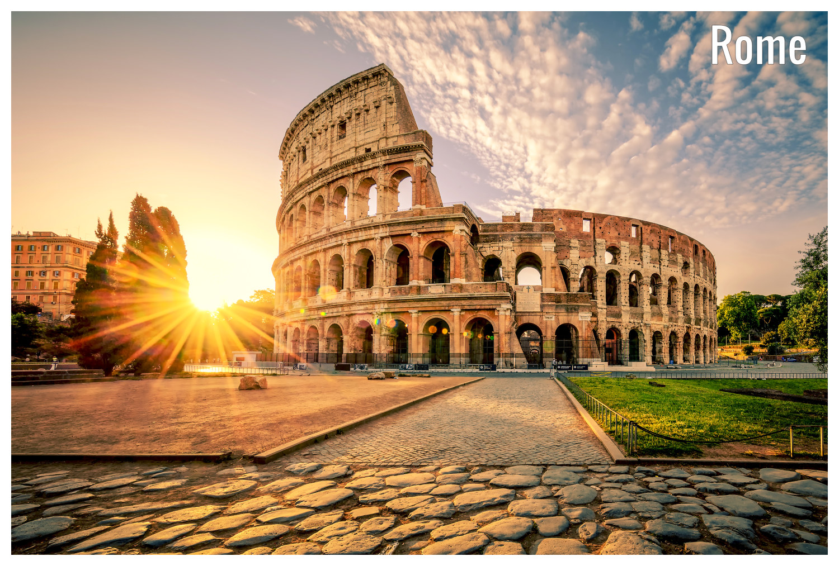

Slide 8
Switzerland
Switzerland, officially the Swiss Confederation, is a country situated at the confluence of Western, Central, and Southern Europe. It is a federal republic composed of 26 cantons, with federal authorities based in Bern. Switzerland is a landlocked country bordered by Italy to the south, France to the west, Germany to the north, and Austria and Liechtenstein to the east. It is geographically divided among the Swiss Plateau, the Alps, and the Jura, spanning a total area of 41,285km and the land area of 39,997km. While the Alps occupy the greater part of the territory, the Swiss population of approximately 8.5 million is concentrated mostly on the plateau, where the largest cities and economic centres are located, among them Zurich, Geneva and Basel.

Slide 9
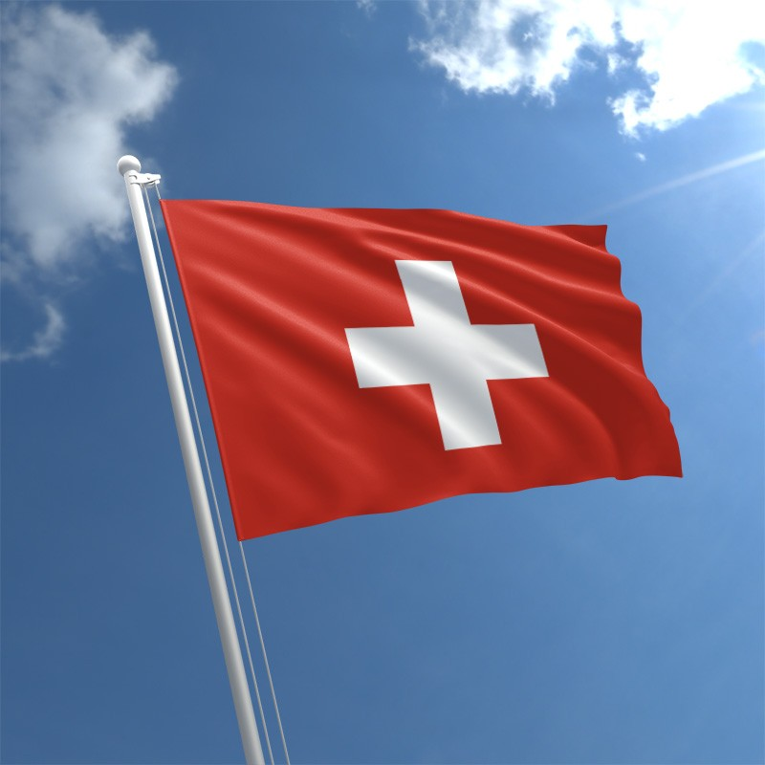
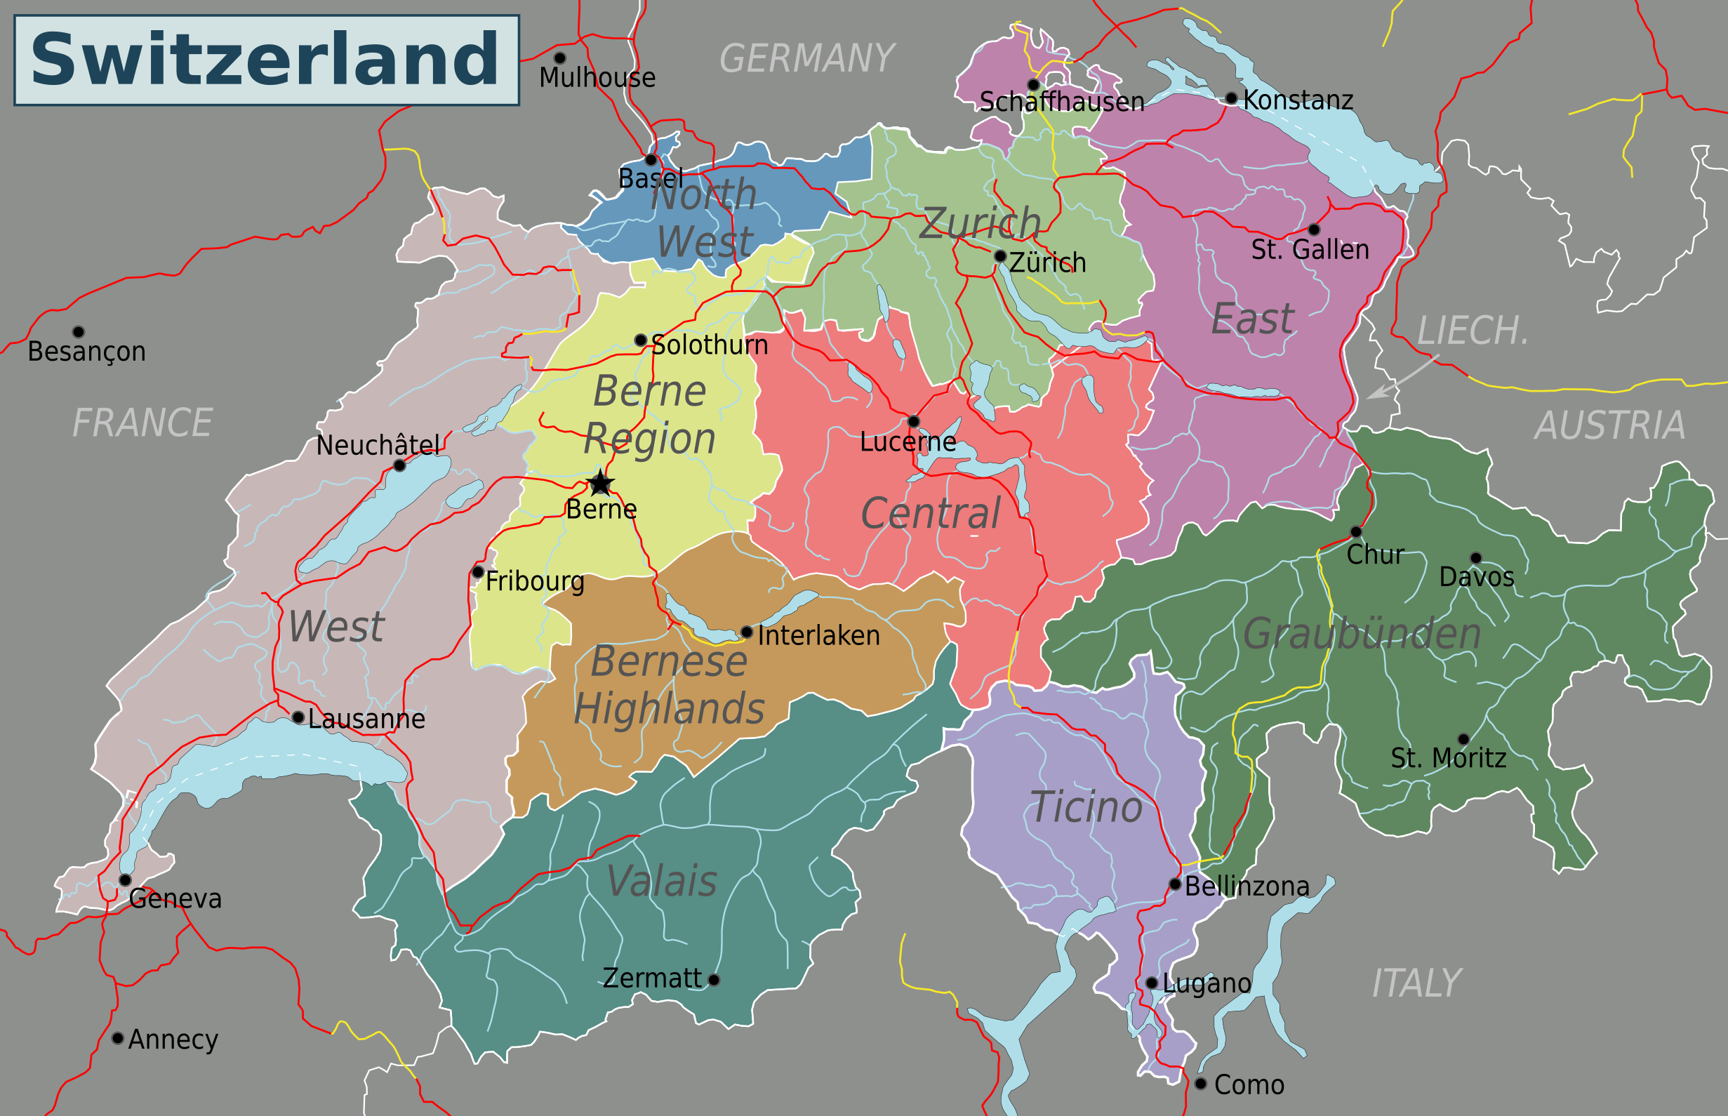
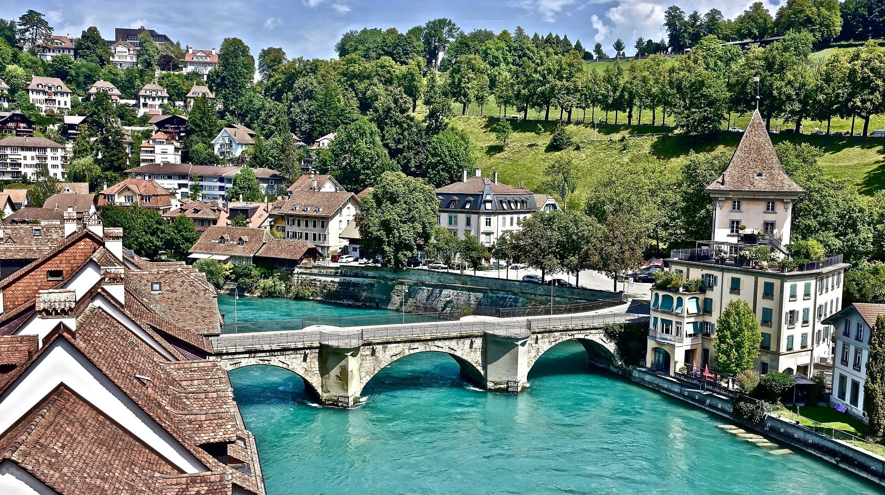
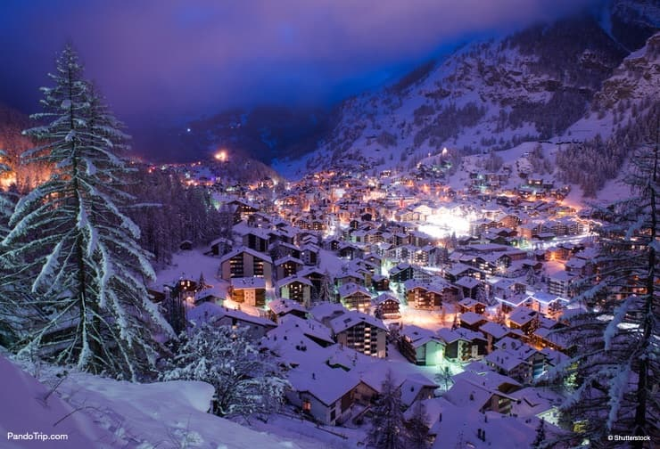

Slide 10
Cuba
Cuba, officially the Republic of Cuba is a country comprising the islands of Cuba as well as Isla de la Juventud and several minor archipelagos. Cuba is located in the northern Caribbean where the Caribbean Sea, Gulf of Mexico and Atlantic Ocean meet. It is east of the Mexico, south of both the U.S. state of Florida and the Bahamas, west of Haiti and north of both Jamaica and the Cayman Islands. Havana is the largest city and capital; other major cities includes Santiago de Cuba and Camaguey. The area Republic of Cuba is 110,860 square kilometers without the territorial waters. The islands of Cuba is the largest island in Cuba and in the Caribbean, with an area of 105,006 square kilometers and the second most populous after Hispaniola, with over 11 million inhabitants.

Slide 11
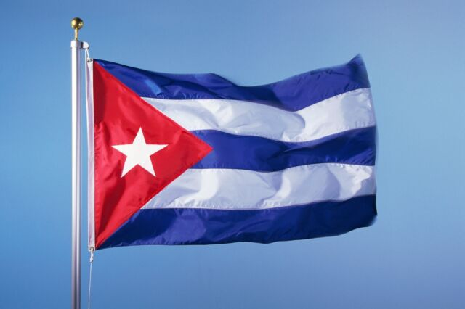
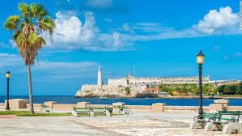
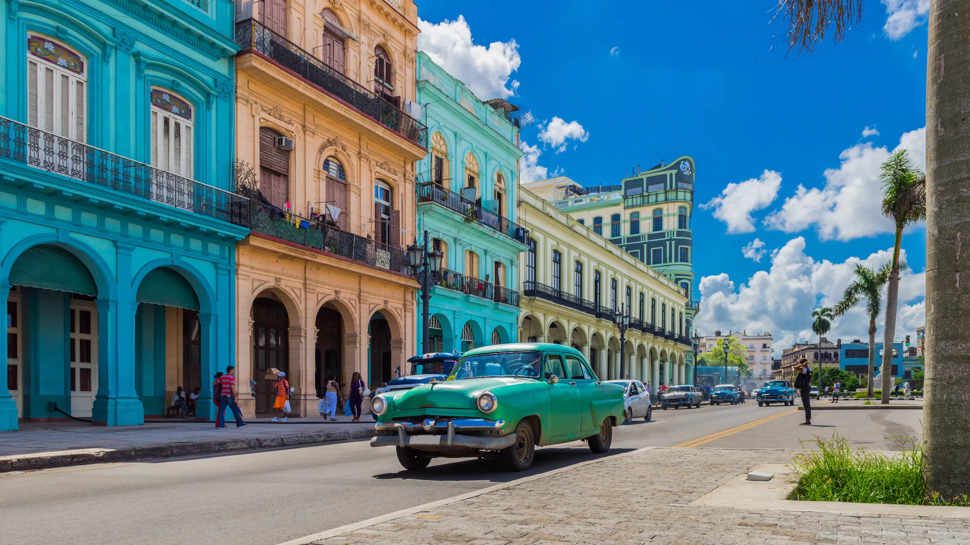
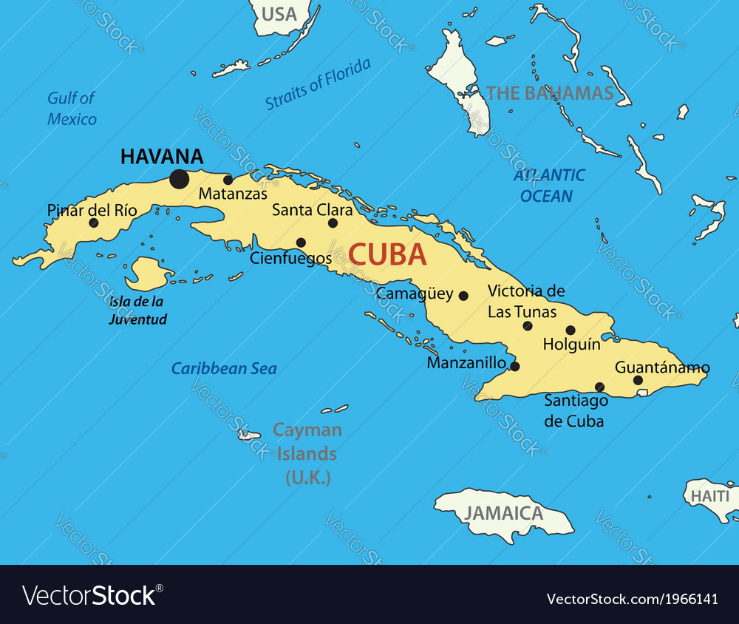

Slide 12
Thanks for watching our presentation
The students of ST1
GROUP B

