Slide 1
FOOTBALL STARS
The best players

Slide 2
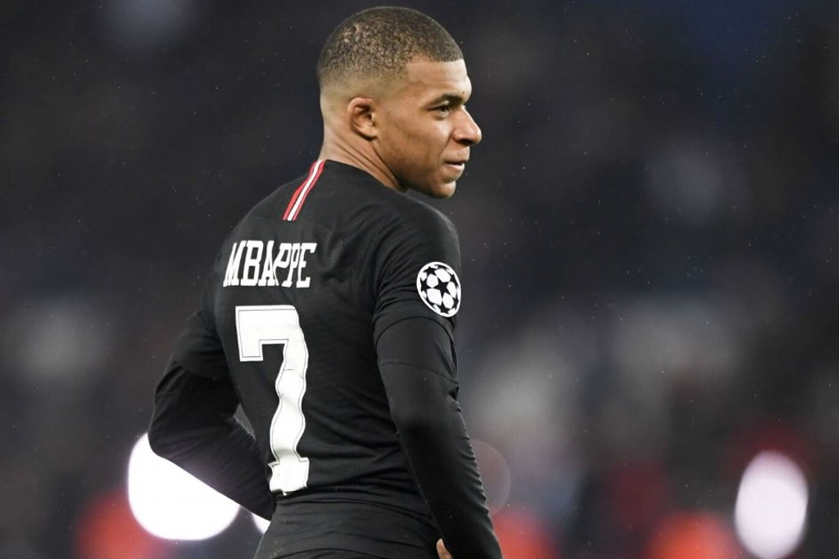
Kylian Mbappé
In his short football career, Kylian Mbappé has broken records galore and scored a famous goal to help France win the 2018 World Cup. If he goes on to fulfill his potential he will surely become one of the best players in the world – he is already one of the fastest. He is born in 1998 in France. He had played for Monaco and now he is playing for PSG. He is playing as a ST.

Slide 3
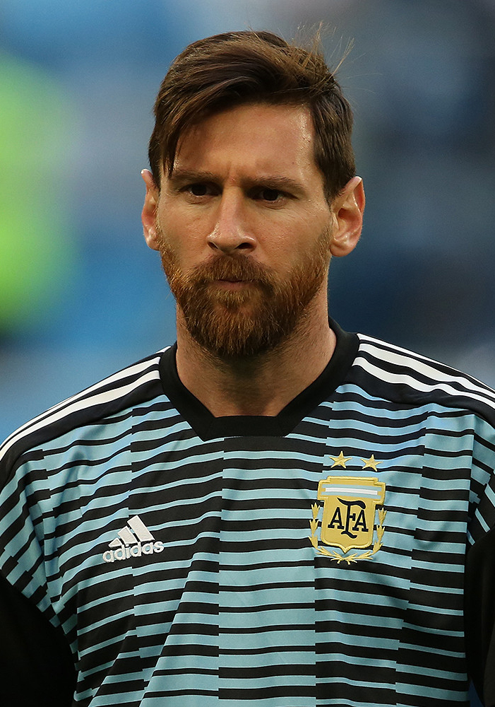
Lionel Messi
Lionel Messi overcame a serious medical condition in childhood to become one of football’s all-time greatest players. A prolific goal-scorer for club and country the Argentinian has won the Ballon D’Or a record-equalling five times, and is the only to have won it 4 years in a row. He was born in 1987 in Argentina. He plays as a RW or CF.

Slide 4
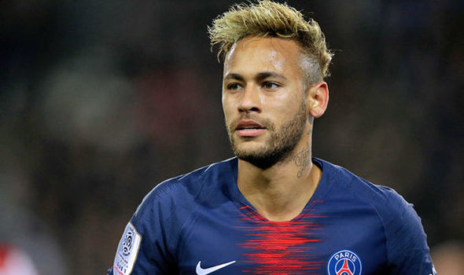
Neymar Jr
Ever since he made his professional debut aged 17, Neymar has displayed a cheeky flamboyance in everything he does. He loves to be creative on pitch taunting defenders with an amazing range of dribbles, He was born in 1992 in Brazil. Hie plays as a LW. Now he plays for PSG and in the past for Barçelona and Santos

Slide 5
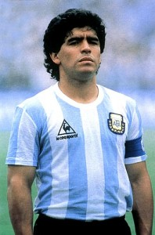
Diego Maradona
Diego Maradona scored arguably the most famous goal in football history. Certainly it was the most infamous. In the Argentina VS England for the quarter-final of the 1986 World Cup, he jumped for a header but instead palmed the ball with his hand and it bounced into the net. The referee didn’t spot the Maradona’s touch with the hand and the goal was regular. Ha was born in 1960 and in Argentina. He had played for Boca Juniors, Barçelona and Napoli as a CAM or CF.

Slide 6
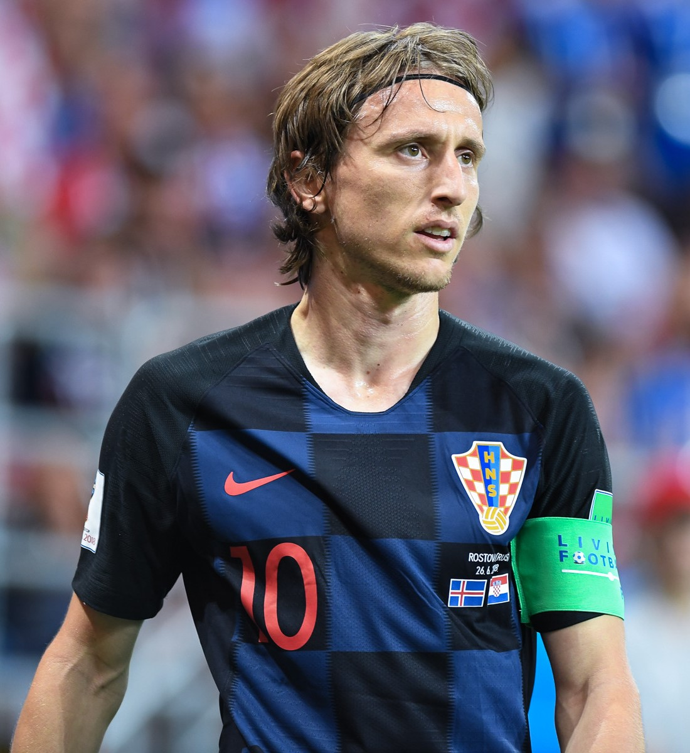
Luca Modric
Luca Modric was told again and again he was too skinny and small to make it. But the classy Croatian proved all his doubters wrong to become arguably the best midfielder of his generation. He has 4 UCL trophies with Real Madrid and in 2018 Ballon D’Or. He stated playing for Totenham Hotspur and then for Real Madrid. He is playing us a CM.

Slide 7
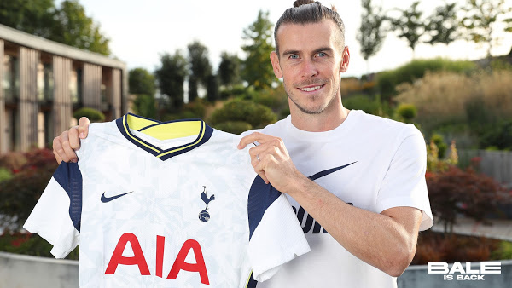
Gareth Bale
Gareth Bale became one of the most expensive player in history when Real Madrid bought him from Spurs for 100 million euros in 2013. but he was worth the money. The Welsh Wizard won 4 UCL finals at Madrid , scoring decisive goals in 3 of them, including one of the most dazzling goals in the history of the tournament. Now he is playing for Spurs and in the past for Real Madrid. He is playing as a RW

Slide 8
Thank u for watching
GROUP B

