Slide 1
Guinness world records at home
Group C ST1

Slide 2

You can try doing that records at home
1You can make balloons and in 30 seconds you must burst.
The people who burst the most balloons is winning.

Slide 3
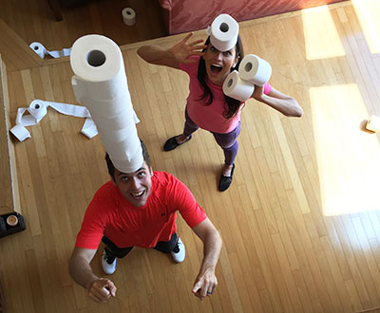
2You have 30 seconds and you must
make the tallest paper tower.

Slide 4
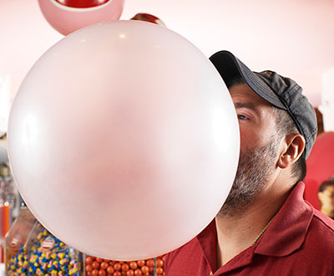
3You can also make the largest
Bubblegum bubble blown.

Slide 5
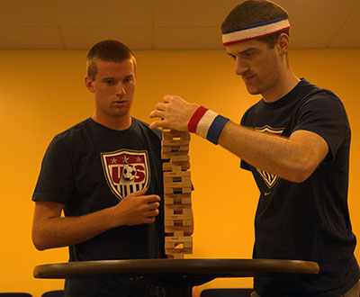
4You can make the fastest Jenga tower in 30 levels.

Slide 6

5You can try make the most 500-ml bottles balanced on
one finger.

Slide 7
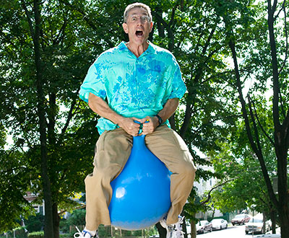
6You can do the fastest 100 m. on a space hopper.
Be careful.

Slide 8
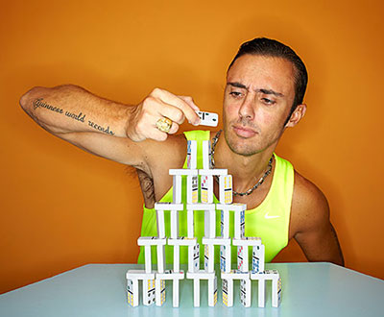
7 You can try make the most dominoes
stacked in 30 seconds.

Slide 9
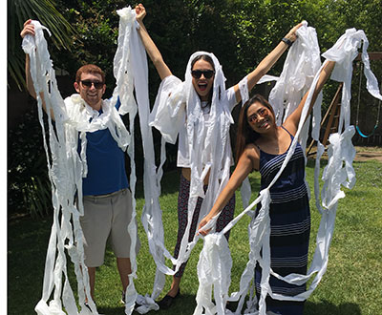
8 You can do also something not very clean but may be is very exciting.
You can do the fastest time to unravel a toilet roll.

Slide 10
The end of records
These are some records of many people. You can try doing that records at home.

