Slide 1


6 Laws Around the World

Slide 2
It's Illegal to Chew Gum in Singapore
Sometimes we all suffer when fools break the rules. After vandals used chewing gum to mess with the Mass Rapid Transit system and the Housing and Development Board spent $150,000 a year to clean gum liter, Singapore banned all gum substances in 1992.
Anyone importing, selling or making gum in Singapore can get fined and/or jail time, with the exception of nicotine and dental gums offering therapeutic value.
Don't get caught blowing bubbles in the streets!

Slide 3


Slide 4
Canadian Radio Stations Must Play Canadian Artists
The Canadians are a patriotic bunch. So much so that all Canadian radio stations are required, by law, to play Canadian artists on the airwaves at least 35 percent of the time, especially during the hours of 6 a.m. and 6 p.m., Monday through Friday.

Slide 5


Slide 6
No Selfies With Buddha in Sri Lanka
When you take a selfie with Buddha, you are turning your back on him. This sign of disrespect is punishable by imprisonment in Sri Lanka. It is also considered disrespectful to point your finger at Buddha, and sometimes there are bans on taking photos with the statues.
.
*Μετάφραση* Όταν κάνετε μια selfie με τον Βούδα, γυρίζετε την πλάτη σας σε αυτόν. Αυτό το σημάδι ασέβειας τιμωρείται με φυλάκιση στη Σρι Λάνκα. Θεωρείται επίσης ασέβεια να δείχνετε το δάχτυλό σας στον Βούδα και μερικές φορές υπάρχουν απαγορεύσεις στη λήψη φωτογραφιών με τα αγάλματα.​

Slide 7


Slide 8
It's Illegal to Feed Pigeons in Venice
With thousands of pigeons descending upon Saint Mark's Square and Venice, lured by the tourists readily handing out food in exchange for Instagram-worthy photos, Venice lawmakers officially made it illegal to feed the pesky fowl in 2008.
It is said the cleanup from the birds cost each citizen €275 per year, so now, the tables are turned. If you're caught feeding the pigeons, you could face fines of up to €700. Better to get the picture-perfect shot of Venice's beautiful bridges instead.
Write the answer in chat
Question:how much money should each person give for the cleanliness of the food falling down to the ground?​

Slide 9


Slide 10
It's Illegal to Wear High Heels to the Acropolis
When packing for a trip to Greece, make sure you have the right shoes. The country banned high heels at the Acropolis in 2009, so no stilettos at the Parthenon. Not sure why anyone would want to make a trek around the ruins and dirt in heels — surely it's tough to walk and will damage the shoes — but the Greeks put this ban in place to protect its ruins from damage caused by the sharp shoes.

Slide 11
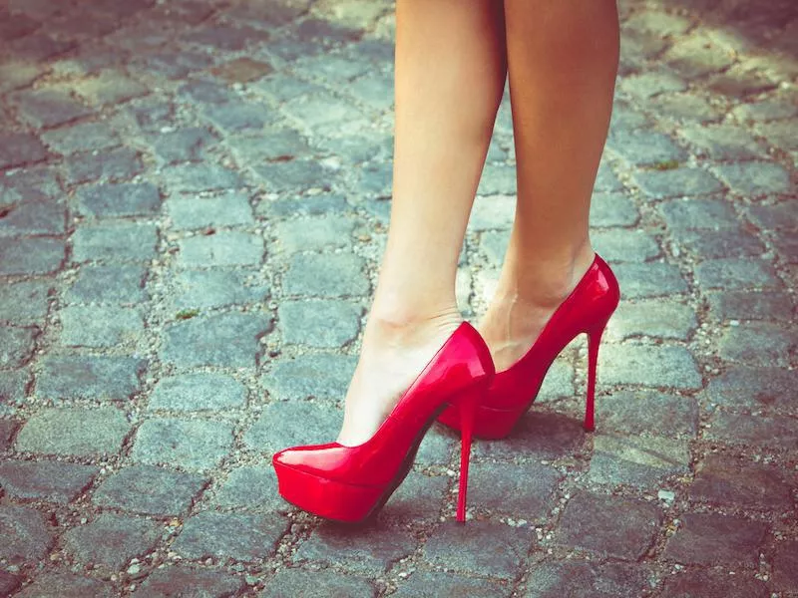

Slide 12
You Must Honk When Passing a Car in New Jersey
When driving along the highway in the Garden State, you are legally required to provide an audible warning that you are about to pass a car on the left.
This means that, whether you're driving on the Garden State Parkway or the New Jersey Turnpike, you technically should honk your horn before you pass, according to state law.
As if the people in Jersey aren't honking enough already.

Slide 13
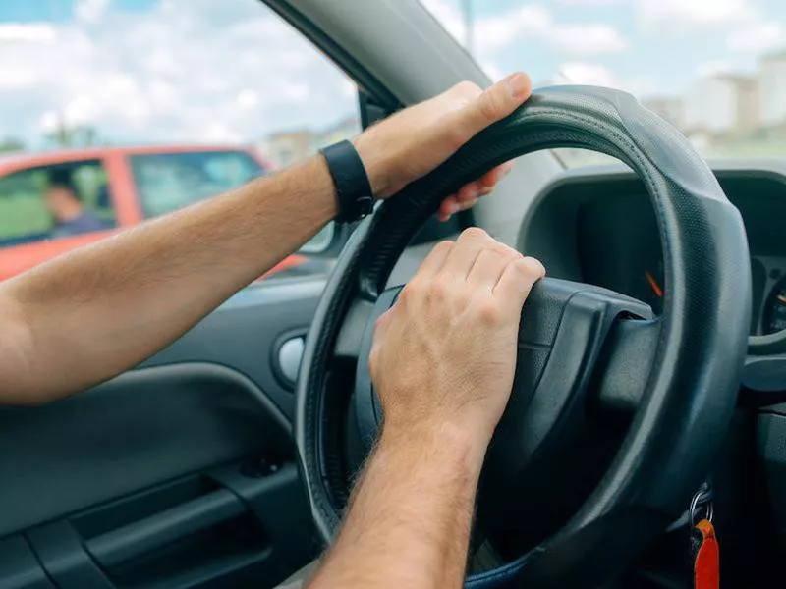

Slide 14
Questions
It's Illegal to Chew Gum in Singapore​
It's Illegal to Feed Pigeons in Venice​
​
How many euros did they spend on chewing gum cleaning and when did they ban all chewing gum substances?​
2.how much money should each person give for the cleanliness of the food falling down to the ground?​​

Slide 15

Thank you for watching our presentation

Slide 16



Happy Easter!!!!

