Slide 1
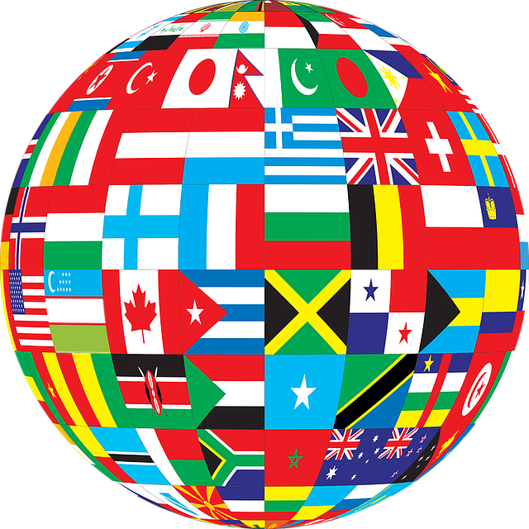
Sights and food from 6 different countries

Slide 2
Austria

Slide 3
Austria , officially the Republic of Austria , is a landlocked East Alpine country in the southern part of Central Europe. It is composed of nine federated states , one of which is Vienna, Austria's capital and largest city. It is bordered by Germany to the northwest, the Czech Republic to the north, Slovakia to the northeast, Hungary to the east, Slovenia and Italy to the south, and Switzerland and Liechtenstein to the west.

Slide 4
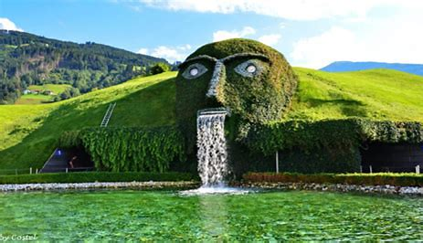
This sight shows the head of a man who long ago fought with a bear to save his country and lost his life

Slide 5
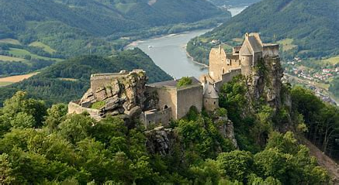
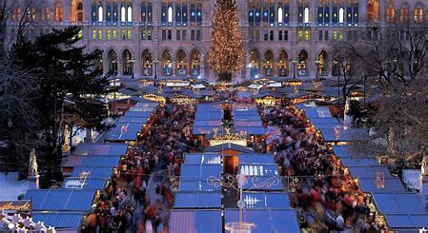
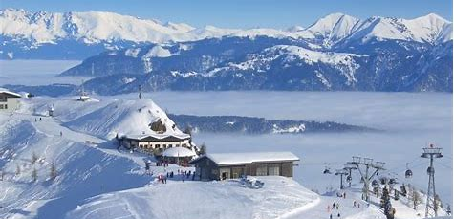
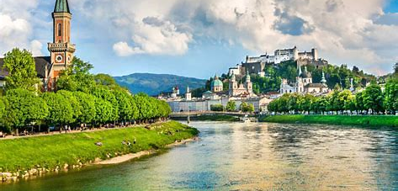

Slide 6
https://www.youtube.com/watch?v=f4CUsG6pmpE

Slide 7
food from Austria
Austrian cuisine is a style of cuisine native to Austria and composed of influences from Central Europe and throughout the former Austro-Hungarian Empire. Austrian cuisine is most often associated with Viennese cuisine, but there are significant regional variations.
Η αυστριακή κουζίνα είναι ένα στυλ κουζίνας που προέρχεται από την Αυστρία και αποτελείται από επιρροές από την Κεντρική Ευρώπη και όλη την πρώην Αυστροουγγρική Αυτοκρατορία. Η αυστριακή κουζίνα συνδέεται συχνότερα με τη βιεννέζικη κουζίνα, αλλά υπάρχουν σημαντικές τοπικές παραλλαγές.

Slide 8
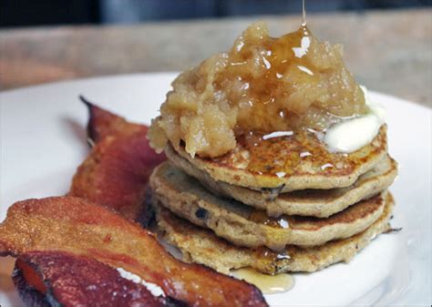
This is the most famous candy in Austria. It's waffles with chocolate filling and on top it's got something like pear pear with honey . Also next to the plate there are chips made from apples.

Slide 9
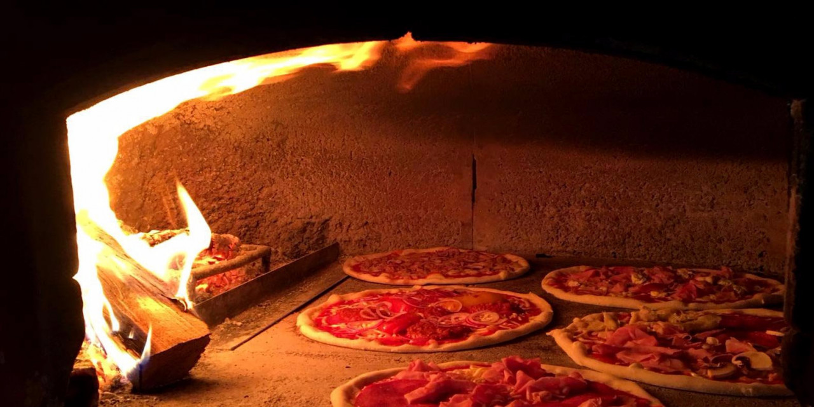
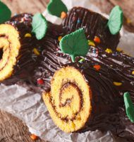
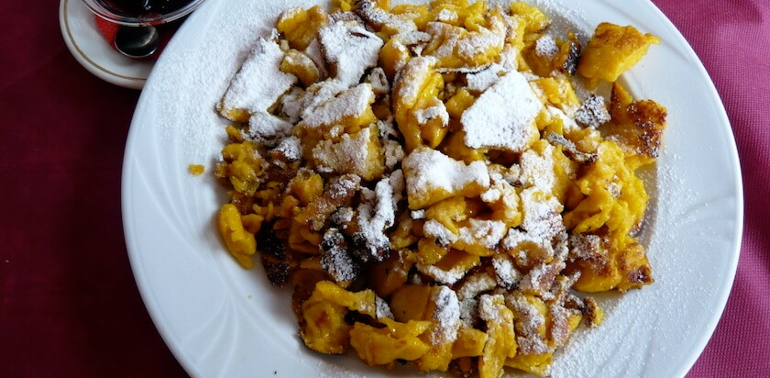

Slide 10
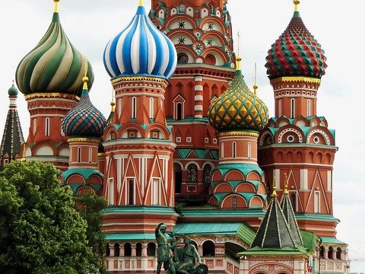
Russia

Slide 11
Russia , is a transcontinental country spanning Eastern Europe and Northern Asia. It is the largest country in the world covering over 17,125,191 square kilometres , consisting of more than one-eighth of the Earth's inhabited land area, extending to eleven time zones, and has bordering sixteen sovereign nations. Russia has a population of 146.7 million and is the ninth-most populous country, as well as the most populous country in Europe.
TRANSCONTINENTAL=Διηπειρωτικη
CONSISTING=Αποτελούμενη
EXTENDING=
Επέκταση
Inhabited=κατοικημενοσ

Slide 12
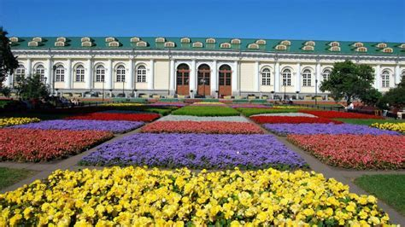
This house belonged to Alexander Garden who lived with his family and now this huge house has become something of a museum that every weekend big and small go there and explore everything.

Slide 13
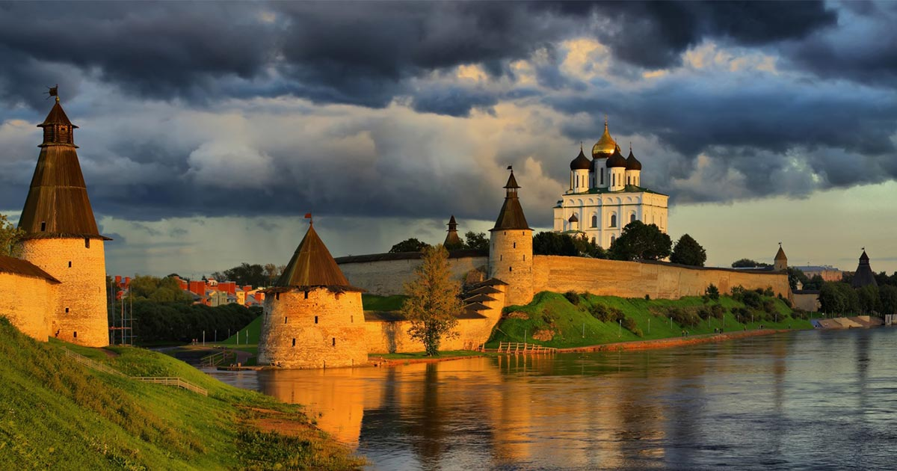
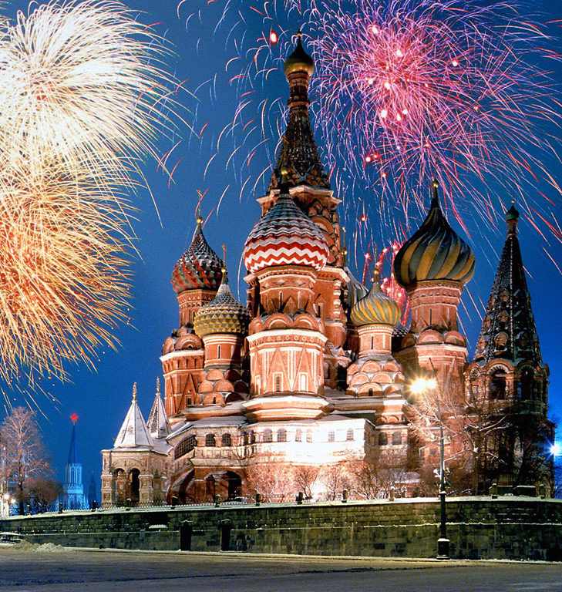
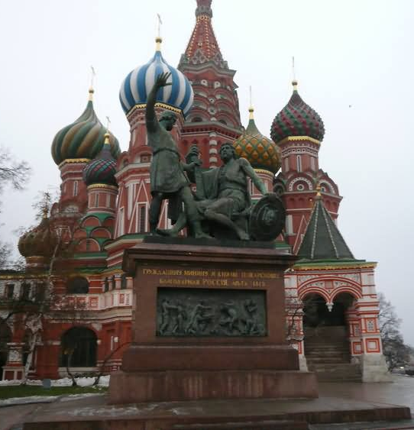
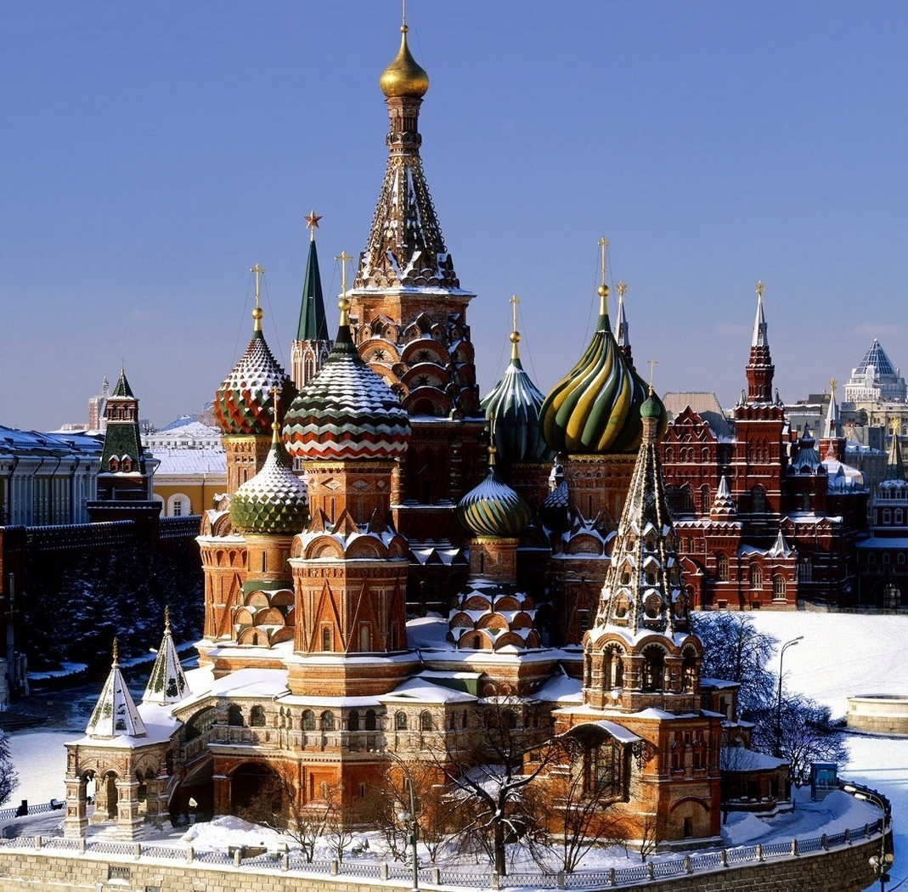

Slide 14
https://www.youtube.com/watch?v=KVKZPxESTrs

Slide 15
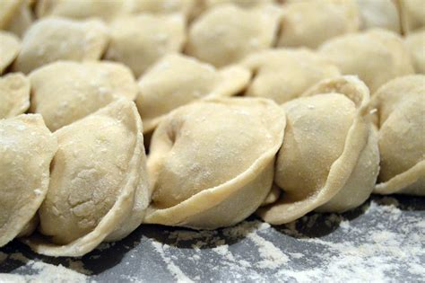
Food from russia
This food is called pilimenia and in my opinion it is the most delicious food there is. It is made from the outside with dough and has a piece of meat inside.

Slide 16
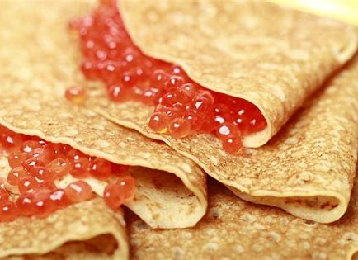
It's crepes that have fish eggs in them, it may seem disgusting to you, but believe me it's not.

Slide 17
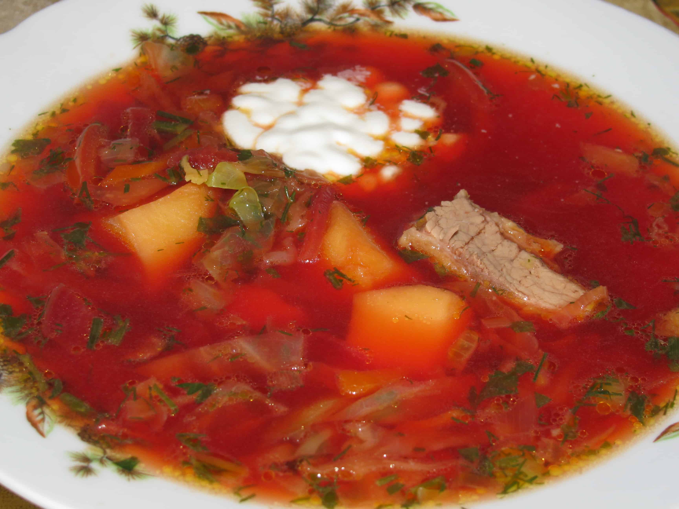
Borsch is the famous soup in many Russian families, as well as many Eastern and Central European countries. Its recipes vary greatly and I do it quite differently from many but beetroot and white cabbage are always there. Beetroot – that is what gives Borsch its trademark red colour.

Slide 18
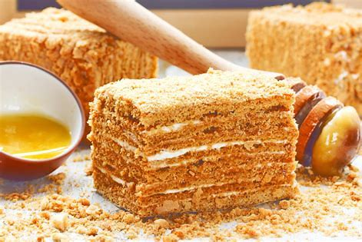
Medovik
The cake was created in the 19th century in the Russian Empire by a young chef who sought to impress Empress Elizabeth Alexeievna, wife of Alexander I. Empress Elizabeth couldn’t stand honey, and any dish made with it drove her mad. One day, however, a young new confectioner in the Imperial kitchen didn’t know the Empress' dislike, and he baked a new cake with honey and thick sour cream. Surprisingly, and unaware of the honey content, Empress Elizabeth immediately fell in love with it.

Slide 19
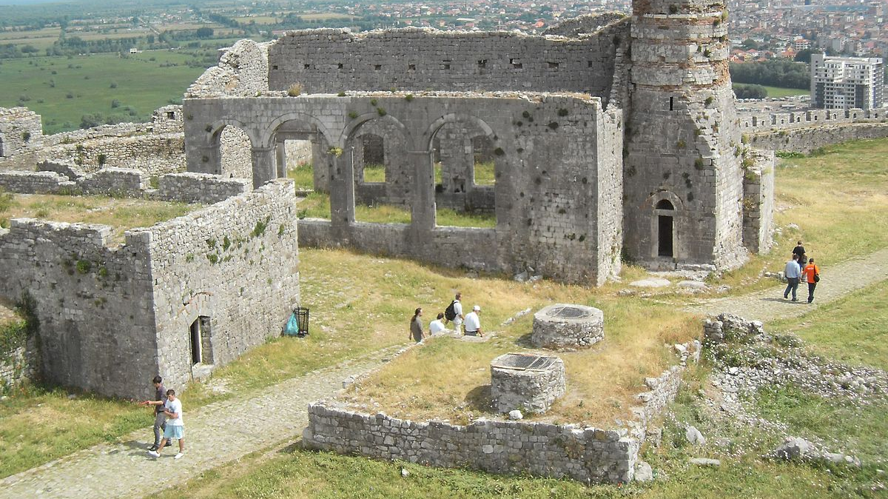
aLBANIA
This Photo by Unknown author is licensed under CC BY-SA.

Slide 20
Albania or Shqipëri, officially the Republic of Albania is a country in Southeastern Europe.It is located on the Adriatit and Ionian Sea within the Mediterranean Sea, and shares land borders with Montenegro to the northwest, Kosovoto the northeast, North Macedonia to the east, Greece to the south. Tirana is its capital and largest city, followed by Durrës, Vlorë and Shkodër.
Historically, Albania has been inhabited by numerous civilisations such as the Illyrians, Thracians, Ancient Greeks, Romans, Byzantines, Venetians and Ottomans.
*κατοικήθηκε από πολλούς πολιτισμούς όπως οι Ιλλυριοί, οι Θράκες, οι Αρχαίοι Έλληνες, οι Ρωμαίοι, οι Βυζαντινοί, οι Ενετοί και οι Οθωμανοί.

Slide 21
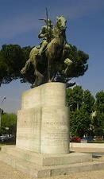
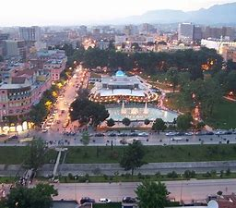
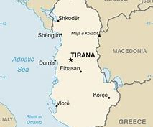
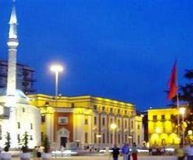
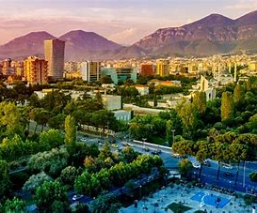

Slide 22
ALBANIAN FOOD

Slide 23
reshedi
Reshedi is something like a cake that its come from Albania. To bake then you need:
250 g of starch (a bowl of starch) 500 gr.water (2 cups of water) 80 Gr. butter 300 Gr sugar

Slide 24
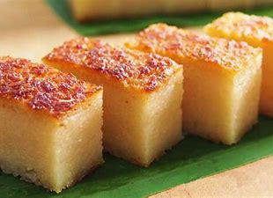

Slide 25
ATTRACTIONS THAT people SHOULD VISIT
Krujë is a town and a municipality in north central Albania. Located between Mount Krujë and the Ishëm River, the city is only 20 km north from the capital of Albania, Tirana.
δήμος

Slide 26
Krujë
Krujë was inhabited by the ancient Illyrian tribe of the Albani. In 1190 Krujë became the capital of the first Albanian state in the middle ages, the Principality of Arbër. Later it was the capital of the Kingdom of Albania, while in the early 15th century Krujë was conquered by the Ottoman Empire, but then recaptured in 1443 by Skanderbeg, leader of the League of Lezhë, who successfully defended it against three Ottoman sieges until his death in 1468.
*Translate*
Ο Krujë κατοικήθηκε από την αρχαία φυλή Illyrian του Albani. Το 1190 ο Krujë έγινε η πρωτεύουσα του πρώτου Αλβανικού κράτους στο Μεσαίωνα, το Πριγκιπάτο του Arbër. Αργότερα ήταν η πρωτεύουσα του Βασιλείου της Αλβανίας, ενώ στις αρχές του 15ου αιώνα ο Krujë κατακτήθηκε από την Οθωμανική Αυτοκρατορία, αλλά στη συνέχεια ανακτήθηκε το 1443 από τον Skanderbeg, αρχηγό του Συνδέσμου της Lezhë, ο οποίος το υπεράσπισε με επιτυχία ενάντια σε τρεις οθωμανικές πολιορκίες μέχρι θάνατος το 1468

Slide 27
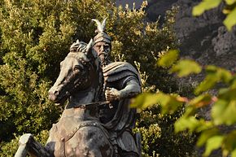

Slide 28
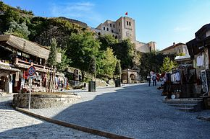

Slide 29
Link with a video
https://youtu.be/EGc0m1Z3q-M

Slide 30
serbia

Slide 31
Serbia
Serbia is a landlocked country situated at the crossroads of Central and Southeast Europe in the southern Pannonian Plain and the central Balkans. It borders Hungary to the north, Romania to the northeast, Bulgaria to the southeast, North Macedonia to the south, Croatia and Bosnia and Herzegovina to the west, and Montenegro to the southwest.
*Translate*
Η Σερβία είναι μια χερσαία χώρα που βρίσκεται στο σταυροδρόμι της Κεντρικής και Νοτιοανατολικής Ευρώπης στην πεδιάδα της νότιας Παννονίας και στα κεντρικά Βαλκάνια. Συνορεύει με την Ουγγαρία στα βόρεια, τη Ρουμανία στα βορειοανατολικά, τη Βουλγαρία στα νοτιοανατολικά, τη Βόρεια Μακεδονία στα νότια, την Κροατία και τη Βοσνία-Ερζεγοβίνη στα δυτικά και το Μαυροβούνιο στα νοτιοδυτικά.

Slide 32
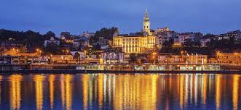

Slide 33
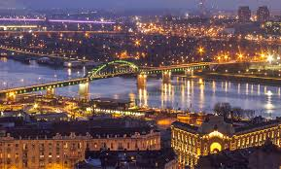

Slide 34
Serbian food

Slide 35
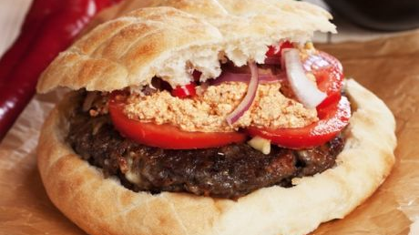
Pljeskavicα

Slide 36
PLJESKAVICΑ
To make this food you need:
400g ground beef,
400g minced pork (minced lamb can also beused)
120g chopped hot pepper, salt,
80g chopped onion,
10g chopped garlic,
40g oil,
40g hard smoked cheese
4 large buns (can be served without buns, like a big "burger
Serbian cuisine has peculiarities but also similarities with our cuisine, since it has influences from Turkey, Greece, but also Central Europe

Slide 37
church of Agios Savvas
The church of Agios Savvas is one of the largest Orthodox temples in the world and generally one of the largest religious buildings.
The church is dedicated to Saint Savvas, founder of the Serbian Orthodox Church, built on the Vračar plateau where the saint's remains were cremated by the Ottomans. Due to its location, the church of Agios Savvas dominates the Belgrade skyline and is the most monumental building in the city.

Slide 38
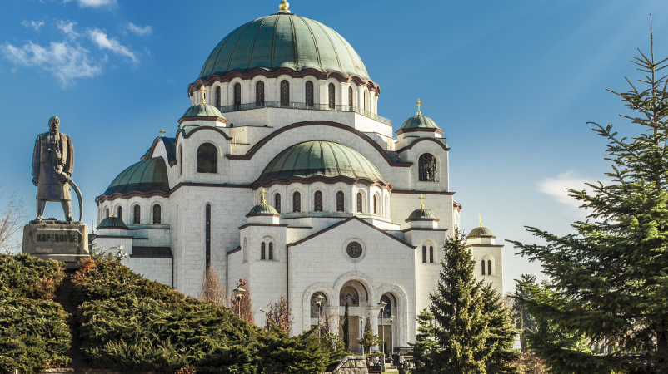

Slide 39
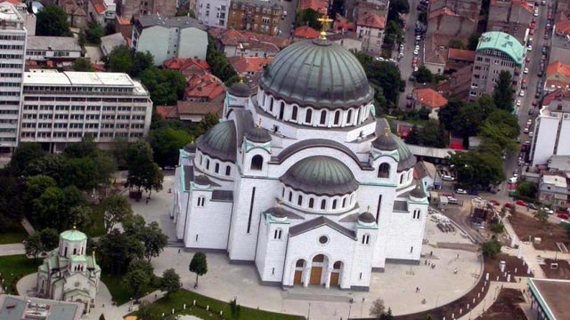

Slide 40
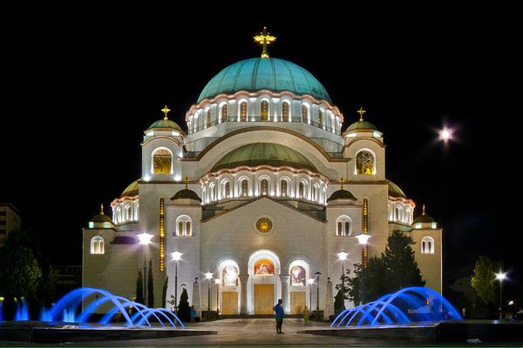

Slide 41
Link with a video
https://youtu.be/AGvTVWNRAu0

Slide 42
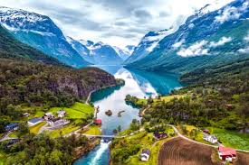
Norway
NORWAY
SIGHTS AND PLACES TO VISIT

Slide 43
ATTRACTIONS THAT CHILDREN SHOULD VISIT
You will find kid-friendly activities and attractions all over Norway. Here are our top tips in six regions that have made an extra effort to make the youngest globetrotters smile.

Slide 44
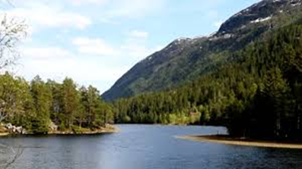
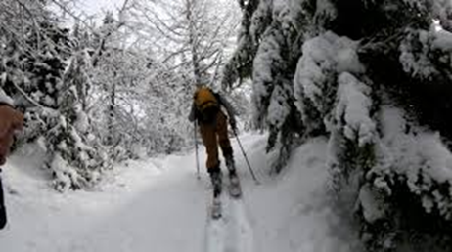
Travel kids in Telemark
During the summer months, an exciting suggestion is to take the kids along the Telemark Canal with MS Telemarken – a pirate ship with a treasure hunt and competitions. Another way to explore the canal is by bike or in a canoe.
A myriad of rivers, lakes and canals make the area perfect for paddling. For an unusual water-based adventure, explore the natural pools and water slides in the giant caves at Nissedal.

Slide 45
Translate in greek
Κατά τους καλοκαιρινούς μήνες, μια συναρπαστική πρόταση είναι να πάρετε τα παιδιά κατά μήκος του καναλιού Telemark με το MS Telemarken - ένα πειρατικό πλοίο με κυνήγι θησαυρού και διαγωνισμούς. Ένας άλλος τρόπος για να εξερευνήσετε το κανάλι είναι με ποδήλατο ή κανό.
Πολλά από ποτάμια, λίμνες και κανάλια κάνουν την περιοχή ιδανική για κωπηλασία. Για μια ασυνήθιστη περιπέτεια με βάση το νερό, εξερευνήστε τις φυσικές πισίνες και τις νεροτσουλήθρες στα τεράστια σπήλαια του Nissedal

Slide 46
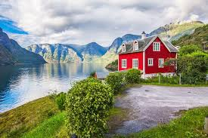
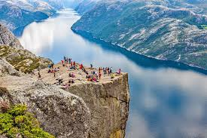
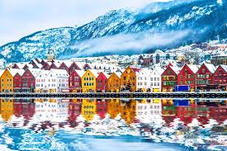
SOME PICTURES OF SIGHTS IN NORWAY

Slide 47
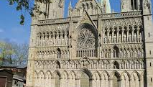
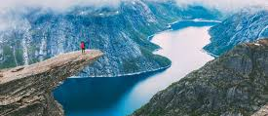
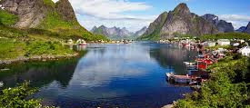
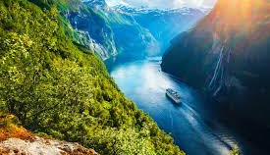

Slide 48
ONE LINK
https://www.youtube.com/watch?v=Y3twUnT0SIk

Slide 49
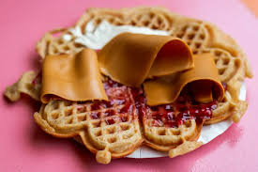
Norwegian cuisine

Slide 50
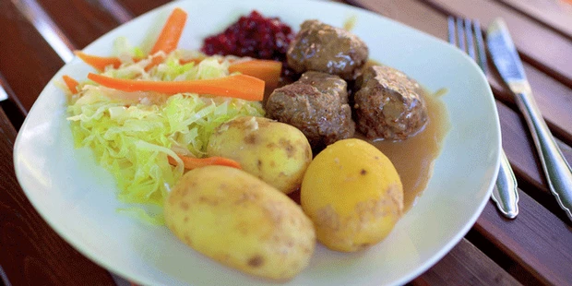
Kjøttkaker

Slide 51
This simple dish is common throughout the country and many families eat it weekly. Minced meat is seasoned and kneaded with a variety of ingredients, such as onions or rusk, before it is formed into small cakes and pan-fried. These are then simmered in gravy and served with either mashed peas or creamed cabbage. This staple is experiencing something of a renaissance after being sidelined by trendier imports like pizza and tacos over the years.
TRANSLATE IN GREEK
Αυτό το απλό πιάτο είναι κοινό σε όλη τη χώρα και πολλές οικογένειες το τρώνε κάθε εβδομάδα. Ο κιμάς καρυκεύεται και ζυμώνεται με ποικιλία συστατικών, όπως κρεμμύδια ή παξιμάδι, προτού διαμορφωθεί σε μικρά κέικ και τηγανιστεί. Στη συνέχεια σιγοβράζονται σε σάλτσα και σερβίρονται είτε με πουρέ μπιζελιών ή με κρέμα λάχανο. Αυτό το βασικό βιώνει κάτι αναγέννησης αφού παραμεληθεί από τις πιο μοντέρνες εισαγωγές όπως πίτσα και tacos με τα χρόνια.

Slide 52
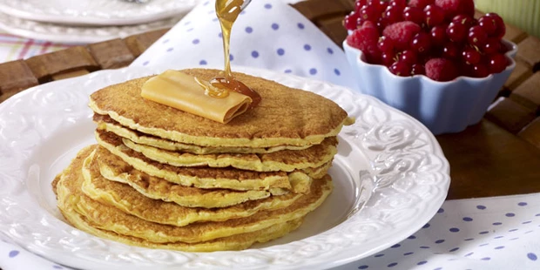
Svele

Slide 53
Originating on the west coast, this batter-based cake has gained popularity throughout the country in the last 40 years. Unlike the American pancakes they resemble, svele is usually an afternoon treat with coffee, eaten warm from the pan. They’re served buttered and covered with anything sweet from syrup to uniquely Norwegian brown cheese. The use of salt of hartshorn (ammonium bicarbonate) and baking soda as raising agents give these cakes their characteristic flavour.
TRANSLATE IN GREEK
Προέρχεται από τη δυτική ακτή, αυτό το κέικ με βάση το κτύπημα έχει αποκτήσει δημοτικότητα σε όλη τη χώρα τα τελευταία 40 χρόνια. Σε αντίθεση με τις αμερικανικές τηγανίτες που μοιάζουν, το svele είναι συνήθως απογευματινό φαγητό με καφέ, που τρώγεται ζεστό από το τηγάνι. Σερβίρονται βουτυρωμένα και καλυμμένα με οτιδήποτε γλυκό από σιρόπι έως μοναδικά νορβηγικό καστανό τυρί. Η χρήση αλατιού του καρφίνου (όξινο ανθρακικό αμμώνιο) και η μαγειρική σόδα ως αυξητικοί παράγοντες δίνουν σε αυτά τα κέικ τη χαρακτηριστική τους γεύση.

Slide 54
spain
SIGHTS

Slide 55
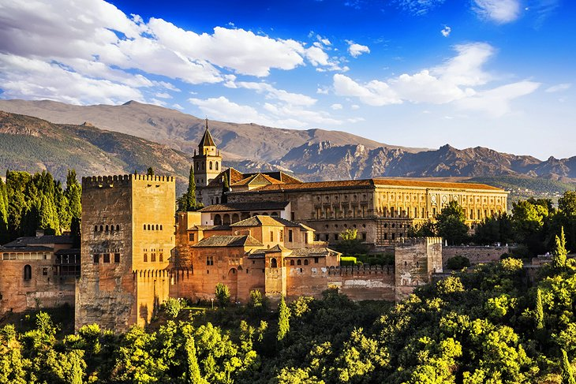
The Alhambra and Generalife Gardens, Granada

Slide 56
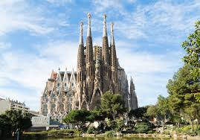
SAGRADA FAMILIA

Slide 57
The Sagrada Familia is an exclusively Roman Catholic beach in Barcelona, ​​Catalonia in appearance, by the Catalan architect Antoni Gaudi. Although incomplete, age appearances UNESCO World Heritage Site and in November 2010 I inaugurate and uninterrupted by Pope Benedict IST΄ difference Royal and request to perform the Divine Liturgy and to have the information.
TRANSLATE IN GREEK
Η Σαγράδα Φαμίλια είναι μεγάλη ρωμαιοκαθολική εκκλησία στη Βαρκελώνη της Καταλονίας στην Ισπανία, σχεδιασμένη από τον Καταλανό αρχιτέκτονα Αντόνι Γκαουντί. Αν και ημιτελής, η εκκλησία αποτελεί Μνημείο Παγκόσμιας Κληρονομιάς της UNESCO και το Νοέμβριο του 2010 εγκαινιάστηκε και καθαγιάστηκε από τον Πάπα Βενέδικτο ΙΣΤ΄ και έγινε Βασιλική και μπορεί πλέον να τελεστεί εκεί η Θεία Λειτουργία και να την παρακολουθήσουν οι πιστοί.

Slide 58


FOOD at spain

Slide 59





Slide 60
ONE VIDEO
https://www.youtube.com/watch?v=jUK9EC28g5A

Slide 61

GROUP C
THANK YOU FOR WATCHING

