Slide 1

ROMANIA
Romania is a very beautiful country and is visited by many tourists.

Slide 2
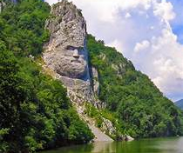
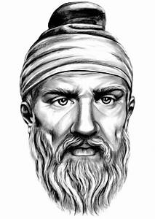
DECEBAL
Decebalus was the last king of Dacia. He is famous for fighting three wars, with varying success, against the Roman Empire under two emperors. After raiding south across the Danube, he defeated a Roman invasion in the reign of Domitian, securing a period of independence during which Decebalus consolidated his rule.
When Trajan came to power, his armies invaded Dacia to weaken its threat to the Roman border territories of Moesia. Decebalus was defeated in 102 AD. He remained in power as a client king, but continued to assert his independence, leading to a final and overwhelming Roman invasion north of the Danube in 105 AD. Trajan reduced the Dacian capital Sarmizegetusa in 106 AD to ruins, absorbing some of Dacia into the Empire. Decebalus committed suicide to avoid capture.

Slide 3
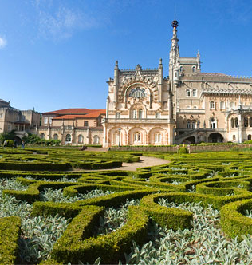
Bucharest
Henri Coanda International Airport (OTP): Bucharest International Airport was renamed Bucharest Otopeni Airport in 2004. It is 17 km from the city center and is located in the northwest of Bucharest. It is the busiest in Romania and has a terminal that serves all flights, international and non-international.

Slide 4
ALBANIA

Slide 5
Albania is a country in Southeast Europe on the Adriatic and Ionian Sea within the Mediterranean Sea. It shares land borders with Montenegro to the northwest, Kosovo to the northeast, North Macedonia to the east, Greece to the south and maritime borders with Greece, Montenegro and Italy to the west.
* maritime borders = θαλάσσια σύνορα

Slide 6
TIRANA
Tirana is the capital and largest city by area and population of the Republic of Albania. It is located in the center of Albania enclosed by mountains and hills with Mount Dajt elevating on the east and a slight valley on the northwest overlooking the Adriatic Sea in the distance. Due to its location at the Plain of Tirana and the close proximity to the Mediterranean Sea, the city is particularly influenced by a Mediterranean seasonal climate.
* enclosed = περίφρακτος
* elevating = ανύψωση
* slight valley = ελαφρά κοιλάδα
* Overlloking = με θέα
* proximity = εγγύτητα
* particularly influenced = επηρεάζεται ιδιαίτερα

Slide 7
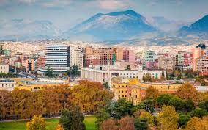
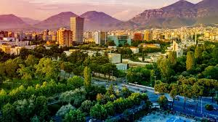

Slide 8
Church of St. Nicholas,
In the city of Leza, in northern Albania, are the ruins of the Church of St. Nicholas, where there is the Mausoleum of Skanderbeg. The temple is also known as the Selimiye Mosque as after the Ottoman domination in the area it was turned into a mosque, but also as a church-mosque (Kisha-Xhami).The church of Agios Nikolaos was built in 1459.
* ruins= ερείπια
* temple = ναός

Slide 9
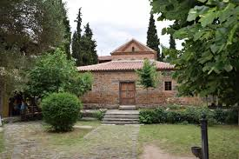
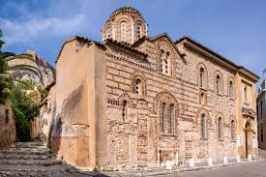

Slide 10
BUTRINT
Butrint was an ancient Greek and later Roman city and bishopric in Epirus. Perhaps inhabited since prehistoric times. In modern times it is an archeological site in Albania, some 14 kilometres south of Sarandë and close to the Greek border. It is located on a hill overlooking the Vivari Channel and is part of the Butrint National Park. Today Bouthrotum is a Latin Catholic titular see and also features the Ali Pasha Castle.
* bishopric = επισκοπή
* Perhaps inhabited = Ίσως κατοικήθηκε
* titular see = τίτλος

Slide 11
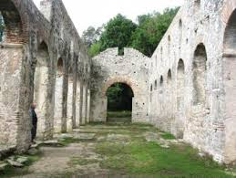
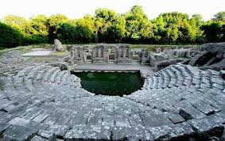
LET SEE SOME PICTURES

Slide 12
London

Slide 13
London is the capital and largest city of England and the United Kingdom. The city stands on the River Thames in the south-east of England. London has been a major settlement for two millennia. Londinium was founded by the Romans.
*stands= στέκεται / βρίσκεται
*a major settlement= ένας σημαντικός οικισμός
* millennia= χιλιετίες

Slide 14
The tower of London
The Tower of London, officially Her Majesty's Royal Palace and Fortress of the Tower of London, is a historic castle on the north bank of the River Thames in central London. It was founded towards the end of 1066 as part of the Norman Conquest of England. The White Tower, which gives the entire castle its name, was built by William the Conqueror in 1078 and was a resented symbol of oppression, inflicted upon London by the new ruling elite.
* entire= ολόκληρος
* resented= δυσαρεστημένος
Oppression= Καταπίεση
Inflicted upon=Προκάλεσε
Ruling elite= κυρίαρχοι

Slide 15
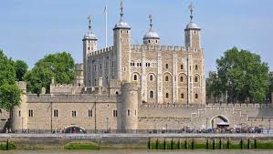
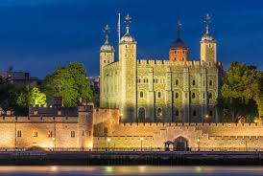

Slide 16
THE LONDON EYE
The London Eye, or the Millennium Wheel, is a cantilevered observation wheel on the South Bank of the River Thames in London. It is Europe's tallest cantilevered observation wheel, and is the most popular paid tourist attraction in the United Kingdom with over 3 million visitors.
* cantilevered observation = πρόβλεψη

Slide 17
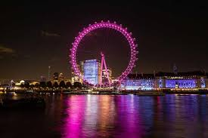
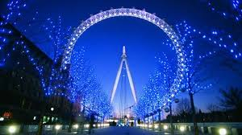

Slide 18
Big Ben
Big Ben is the nickname for the Great Bell of the striking clock at the north end of the Palace of Westminster in London the name is frequently extended to refer to both the clock and the clock tower. The official name of the tower in which Big Ben is located was originally the Clock Tower it was renamed Elizabeth Tower.
* frequently = συχνά
* extended to refer = επεκτάθηκε για αναφορά

Slide 19
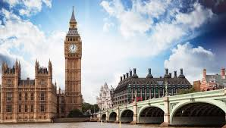
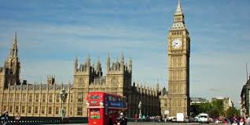

Slide 20
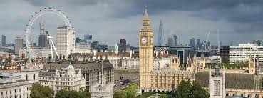
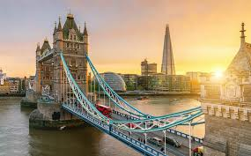
SOME PICTURES OF LONDON

Slide 21
THANKS FOR WATCHING
GROUP C

