Slide 1
Easter customs of foreign countries

Slide 2
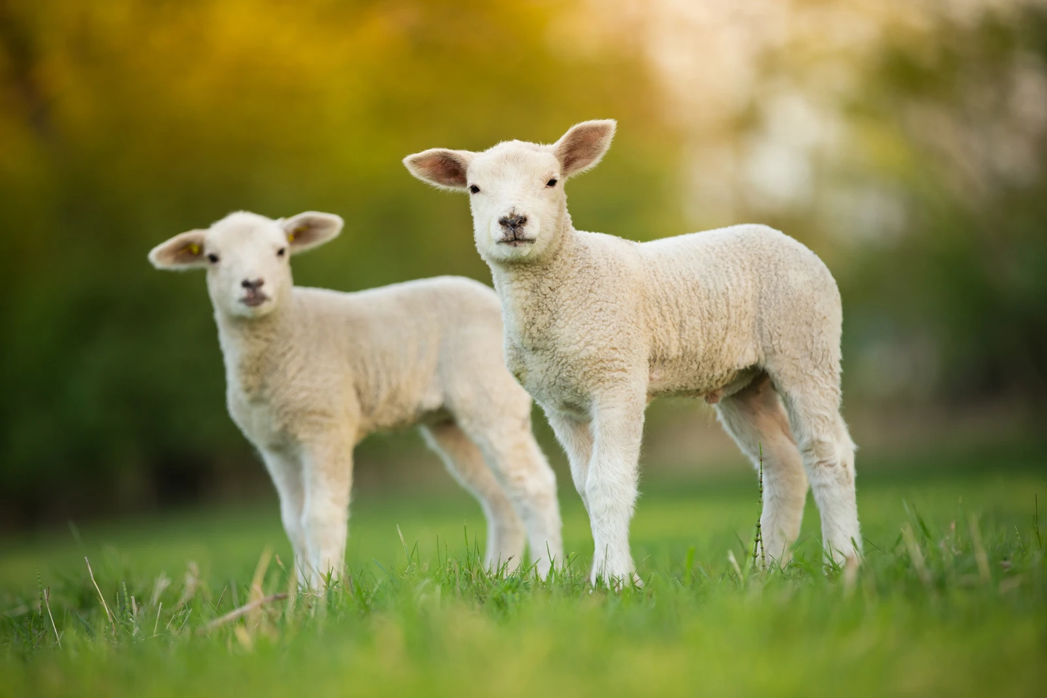
The butter lambs of Russia
In Russia, the Easter meal is accompanied by a knob of butter fashioned into the shape of a lamb. It dates back to ancient times when it was considered a lucky omen to meet a lamb.

Slide 3
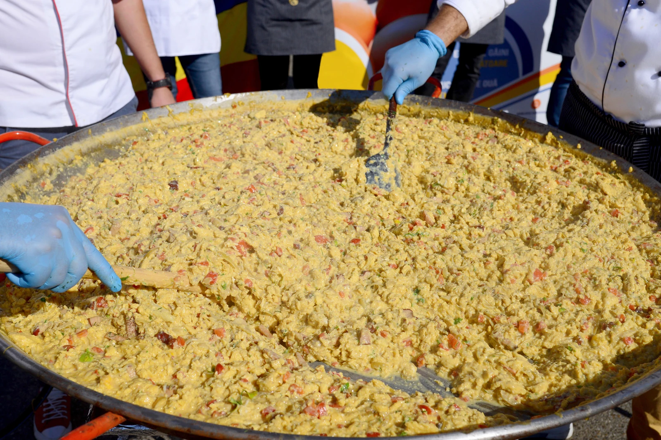
The world's biggest Easter omelette in France
On Easter Monday, the residents of Haux usually crack more than 4,500 eggs into a gigantic pan to create a massive Easter omelette that serves over 1,000 people. Each family breaks the eggs in their homes in the morning and they gather in the main square where the eggs are cooked for lunch. And dinner. And breakfast the next morning...

Slide 4
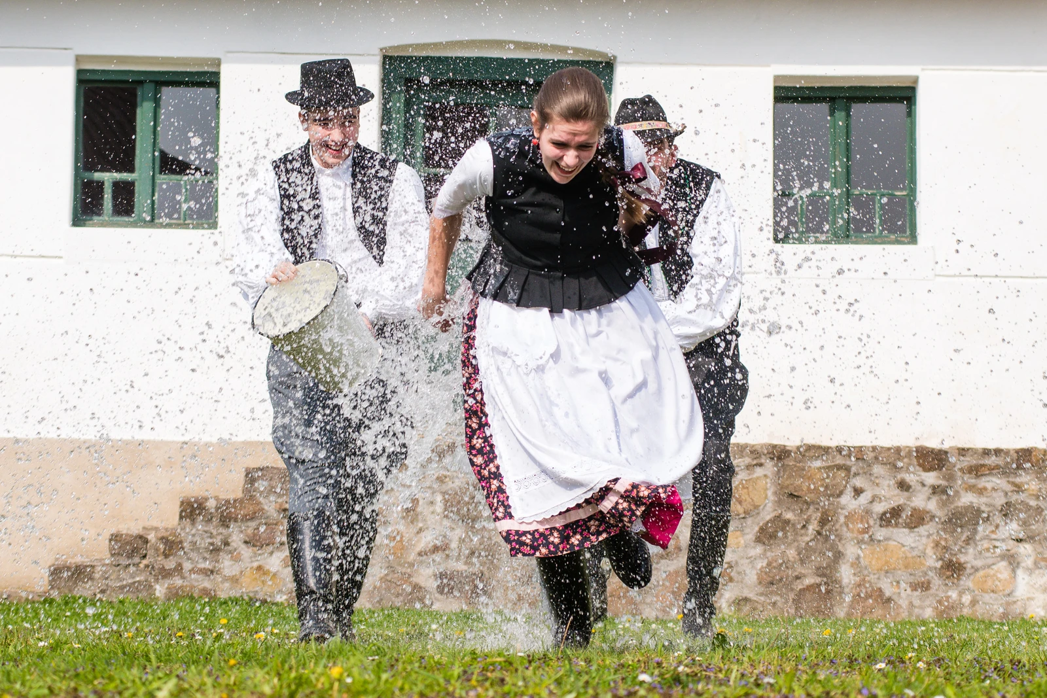
A time to splash out, Hungary
In Hungary, women dress up in traditional clothes on Easter Sunday and get splashed with water.

Slide 5
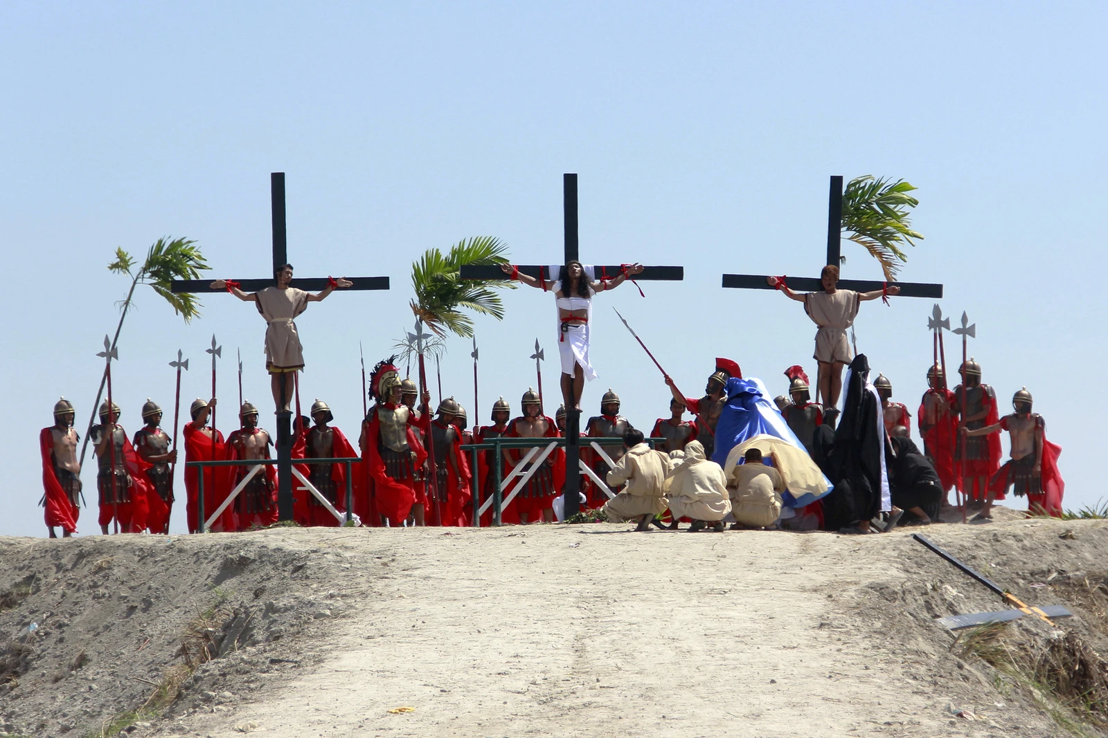
Crucifixion and flagellation in the Philippines
In the Philippines some devout Catholics have taken to the practice of self-crucifixion and self-flagellation on Easter. Their thinking is that it helps purify them and cleanse them of the sins of the world. The Roman Catholic Church is not keen on the idea and has been actively trying to discourage this practice, without much success.

Slide 6
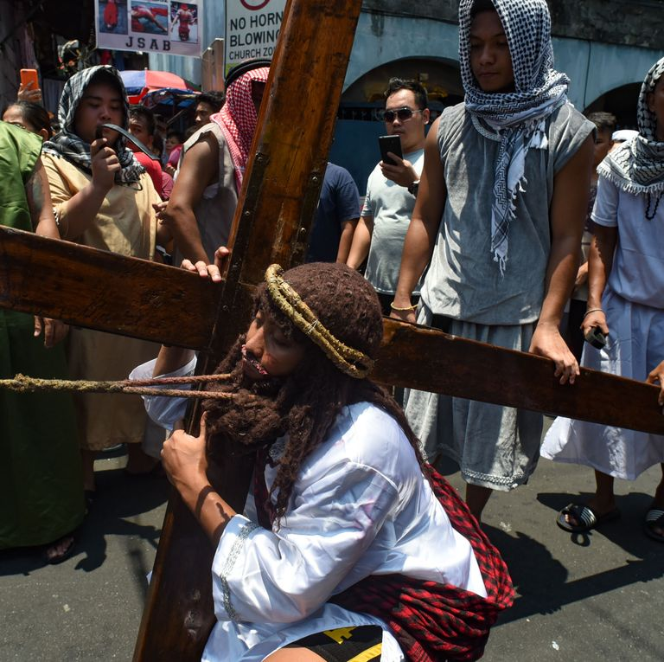
SAN PEDRO CUTUD, THE PHILIPPINES
The Philippines is a mostly Catholic country, so it makes sense that its inhabitants take Easter very seriously. each year on Good Friday, a few people in the northern Philippines are nailed to crosses to honor Jesus' crucifixion.

Slide 7
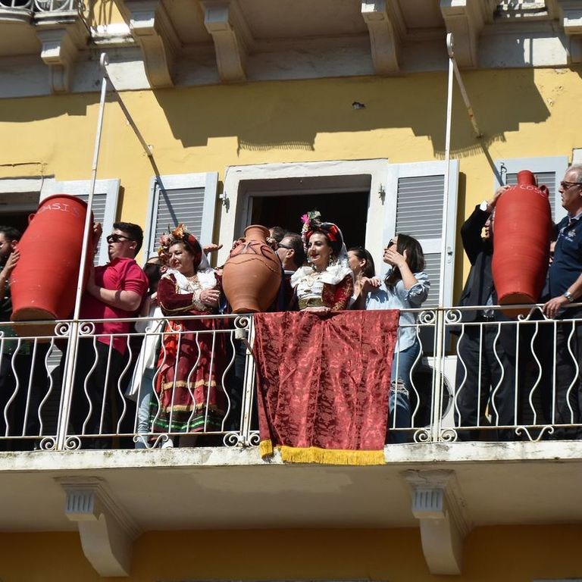
CORFU, GREECE
On the morning of Holy Saturday, the traditional takes place on the Greek island of Corfu. People throw pots, pans, and other earthenware often filled with water out of their windows, smashing them on the street. Some say the custom derives from the Venetians, who on New Year's Day used to throw out all of their old items, . Others believe the throwing of the pots welcomes spring, symbolizing the new crops that will be gathered in the new pots.

Slide 8
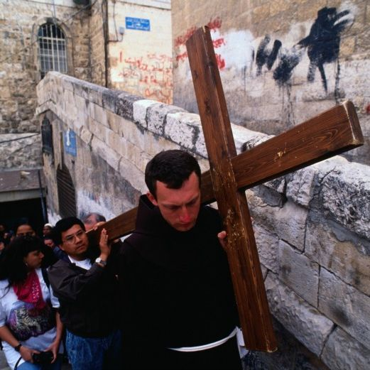
JERUSALEM, ISRAEL
Taking place in the city where it is believed Jesus was crucified, Christians celebrate Good Friday by walking the same path Jesus did on the day he was nailed to the cross, . Taking note of his pain that fateful day, some of those who participate carry a cross with them in remembrance. On Easter Sunday, many pilgrims attend a church service at Garden Tomb — the area it is believed Jesus was buried.

Slide 9
THANKS FOR WATCHING !!!!!
GROUP C

