Slide 1
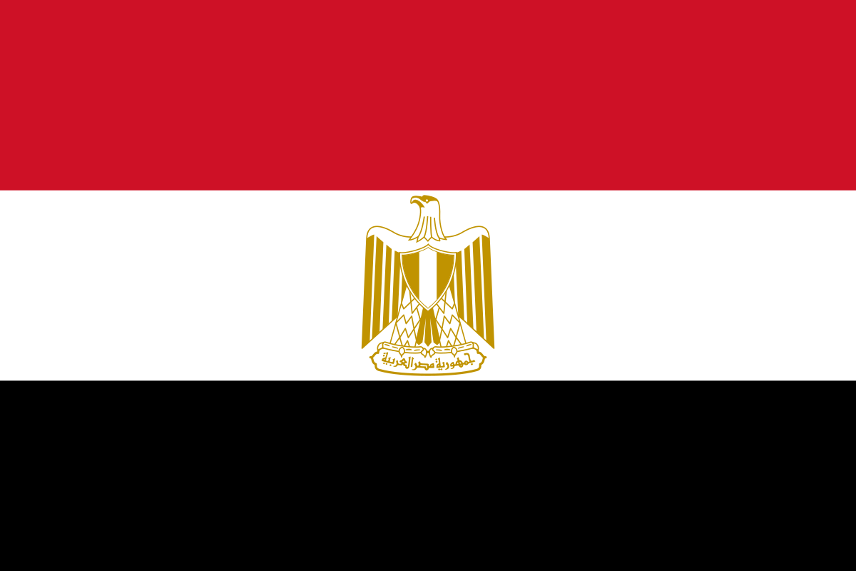
EGYPT
Αυτή η φωτογραφία από Άγνωστος συντάκτης με άδεια χρήσης CC BY-SA

Slide 2
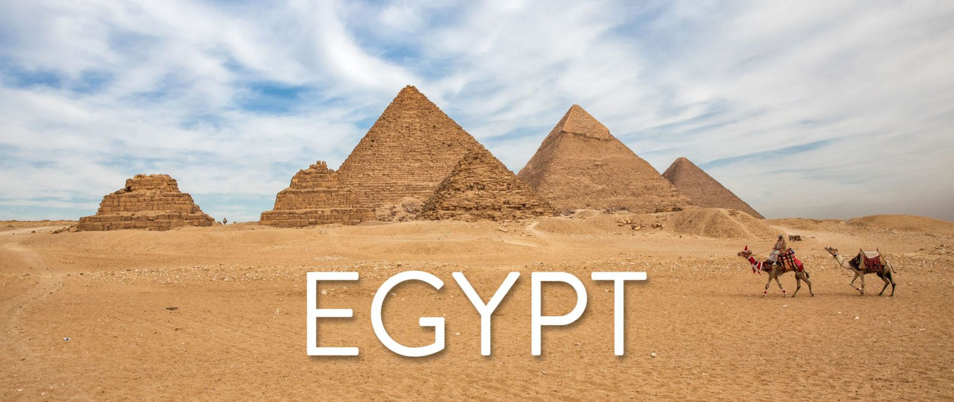
EGYPT
Egypt, is a transcontinental country spanning the northeast corner of Africa and southwest corner of Asia by a land bridge formed by the Sinai Peninsula. Egypt is a Mediterranean country bordered by the Gaza Strip (Palestine) and Israel to the northeast, the Gulf of Aqaba and the Red Sea to the east, Sudan to the south, and Libya to the west. Across the Gulf of Aqaba lies Jordan, across the Red Sea lies Saudi Arabia, and across the Mediterranean lie Greece, Turkey and Cyprus, although none share a land border with Egypt.

Slide 3
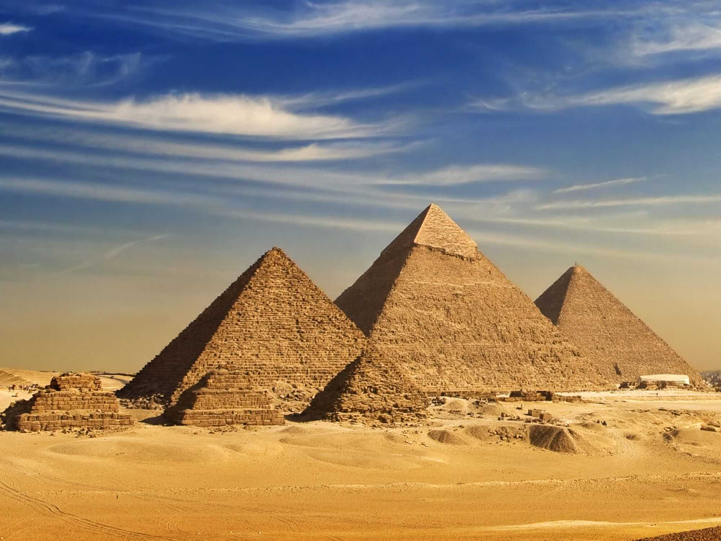
THE FAMOUS PYRAMIDS
The earliest known Egyptian pyramids are found at Saqqara, northwest of Memphis, although at least one step-pyramid-like structure has been found at Saqqara, dating to the 1st Dynasty: Mastaba 3808, which has been attributed to the reign of Pharaoh Anedjib, with inscriptions, and other archaeological remains of the period, suggesting there may have been others. The otherwise earliest among these is the Pyramid of Djoser built c. 2630–2610 BC during the Third Dynasty. This pyramid and its surrounding complex are generally considered to be the world's oldest monumental structures constructed of dressed masonry.

Slide 4
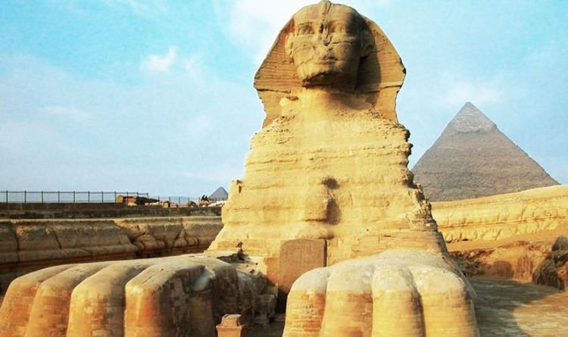
THE SPHINX
The Great Sphinx of Giza, commonly referred to as the Sphinx of Giza or just the Sphinx, is a limestone statue of a reclining sphinx, a mythical creature with the body of a lion and the head of a human. Facing directly from West to East, it stands on the Giza Plateau on the west bank of the Nile in Giza, Egypt. The face of the Sphinx is generally believed to represent the pharaoh Khafre.

Slide 5
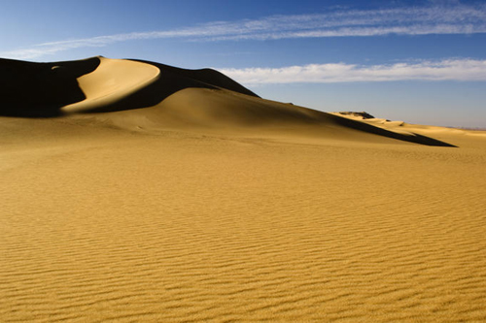
THE WESTERN DESERTS
The Western Desert of Egypt is an area of the Sahara which lies west of the river Nile, up to the Libyan border, and south from the Mediterranean sea to the border with Sudan. It is named in contrast to the Eastern Desert which extends east from the Nile to Red Sea. The Western Desert is mostly rocky desert, though an area of sandy desert, known as the Great Sand Sea, lies to the west against the Libyan border. The desert covers an area of 680,650 km2 (262,800 sq mi) which is two-thirds of the land area of the country.[1] Its highest elevation is 1,000 m (3,300 ft) in the Gilf Kebir plateau to the far south-west of the country, on the Egypt-Sudan-Libya border. The Western Desert is barren and uninhabited save for a chain of oases which extend in an arc from Siwa, in the north-west, to Kharga in the south. It has been the scene of conflict in modern times, particularly during the Second World War.

Slide 6
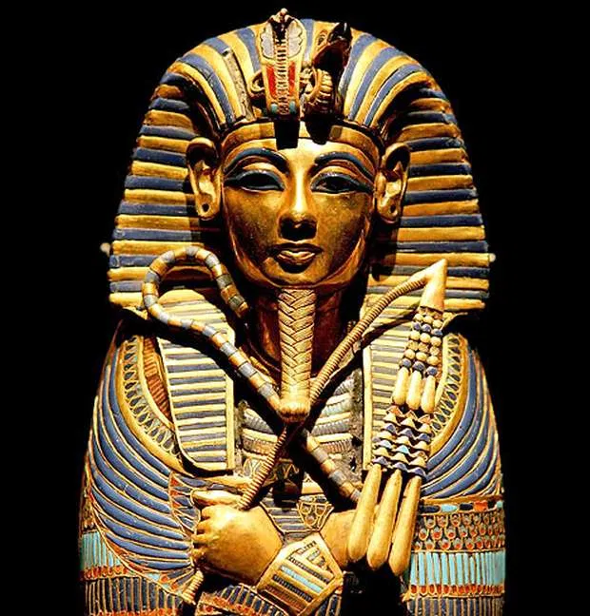
Pharaoh
Pharaoh is the common title now used for the monarchs of ancient Egypt from the First Dynasty until the annexation of Egypt by the Roman although the term "pharaoh" was not used contemporaneously= (συγχρόνως) for a ruler, during the nineteenth dynasty, "king" being the term used most frequently until the middle of the eighteenth dynasty. In the early dynasties, ancient Egyptian kings used to have up to three titles: the Horus, the Sedge =(σπαθόχορτο) and Bee, and the Two Ladies or Nebty =(ντεμπί) named. The Golden Horus =(ώρες) as well as the nomen and prenomen titles were added later.

Slide 7
Thanks for watching!
GROUP B

